Slide 1
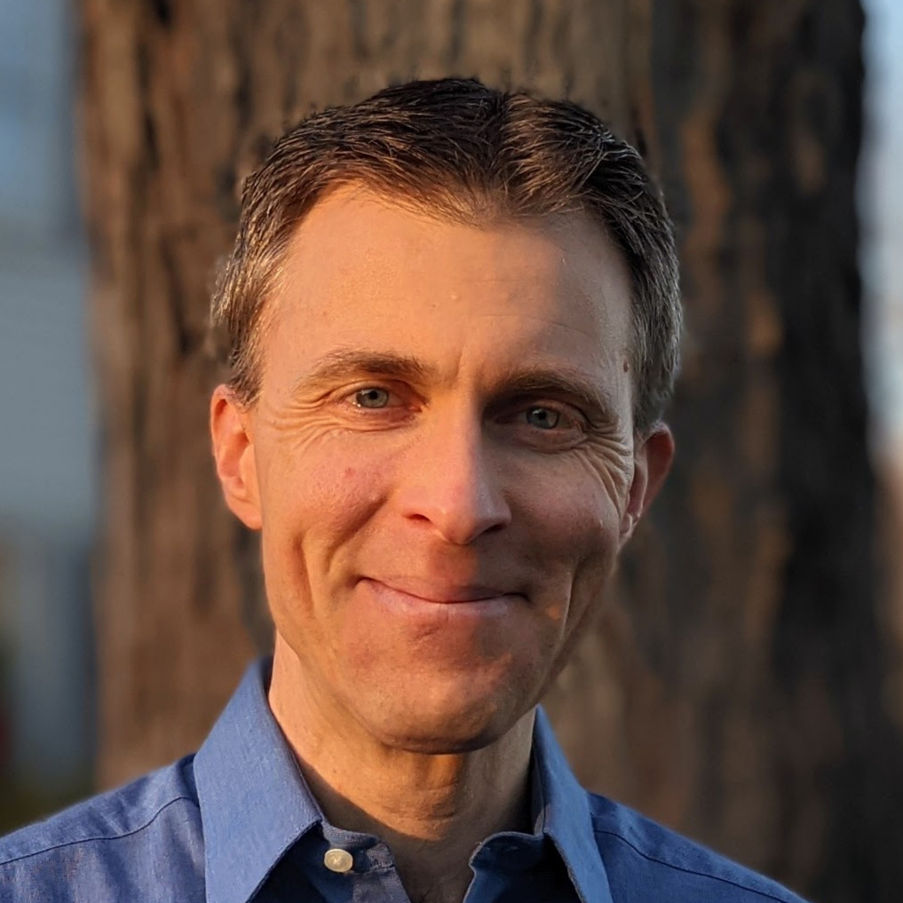
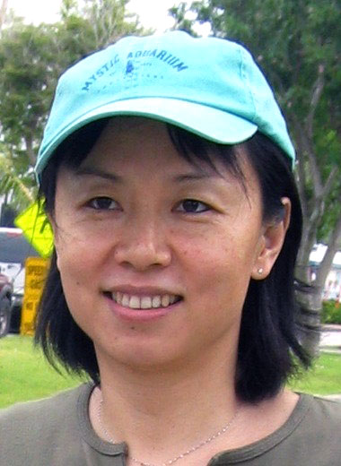
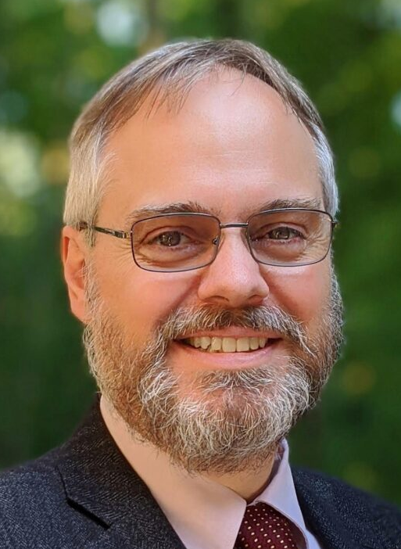
Understanding Equatorial Pacific Climate Processes
via Hierarchical Coupled Modeling
Andrew Wittenberg, Brandon Reichl, Fanrong Zeng (NOAA/GFDL)
Xian Wu, Feiyu Lu, Alistair Adcroft (Princeton/AOS/CIMES)
Thanks to: NOAA/CPO Climate Variability & Predictability Program
New postdoc
arriving March 2023!
(NCAR → Princeton)
Andrew Wittenberg
NOAA GFDL
Xian Wu
Princeton Univ.
Brandon Reichl
NOAA GFDL
Fanrong Zeng
NOAA GFDL
Feiyu Lu
Princeton Univ.
Alistair Adcroft
Princeton Univ.

Slide 2
Improving modeling is a key motivation for the new TPOS backbone & process studies.
Project reports:
Rep 1 (Cravatte et al. 2016): “An urgent need to improve the skill, effectiveness & efficacy of modeling systems that are critical to realizing the impact of an improved TPOS… and to advance understanding & modeling through observing system infrastructure for process studies.”
Rep 2 (Kessler et al. 2019): “Promote observing approaches that jointly measure the ocean & marine boundary layers and air-sea fluxes, principally to support model development…, improve representation of key processes, constrain the coupled system, address biases in observations & models, and improve coupled data assimilation.”
Rep 3 (Kessler et al. 2021): “Encourage process studies leading to improved process parameterizations, towards reducing model biases that degrade the efficacy of observational initializations… Accelerate advances in understanding & predicting tropical Pacific variability… models and their assimilation products are an essential element.”
⇒ Called for denser obs (y & z) in cold tongue; more currents & surface fluxes

Slide 3
NOAA Climate Program Office (CPO) Climate Variability & Predictability (CVP) Program
Observation & Modeling in support of
Tropical Pacific Process Studies, Pre-Field-II
Pacific Upwelling & Mixing Physics (PUMP), and
Air-sea Interaction at the Eastern Edge of the Warm Pool (EEWP)
Key focus: What should TPOS measure to improve
understanding, modeling, and predictions?
8 new projects funded for 2023-2025
(building on 8 prior projects funded by Pre-Field-I, 2019-2021)
Ocean data assimilation & USV/UAV OSSEs (Mazloff et al.; Serra et al.; Zhang et al.)
Coupled boundary layers, fluxes, waves (Seo et al.; Subramanian et al.; Clayson et al.)
Improving mixing in OGCMs (Deppenmeier et al.)
Improving CGCMs for forecasts & projections (Wittenberg et al., GFDL/Princeton)

Slide 4
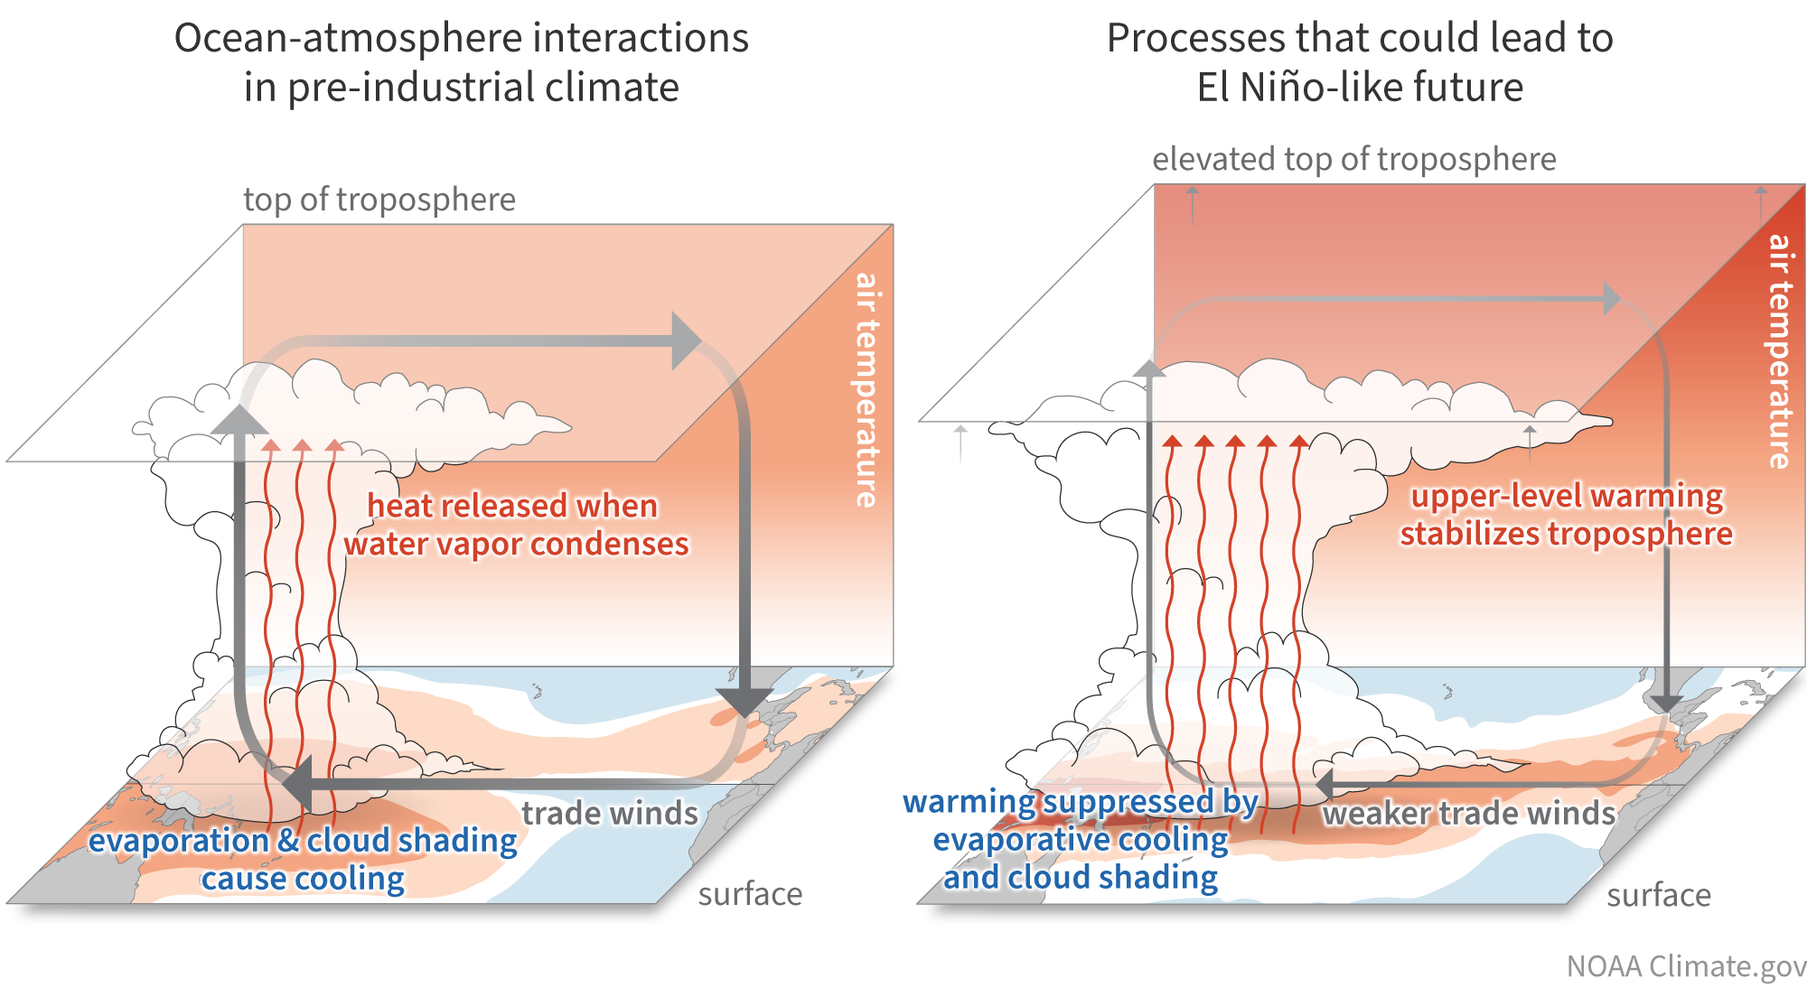
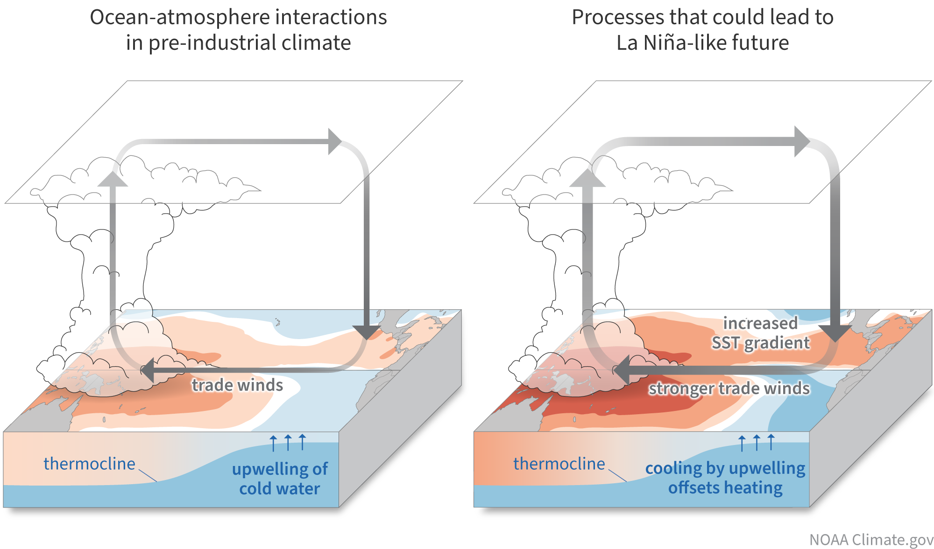
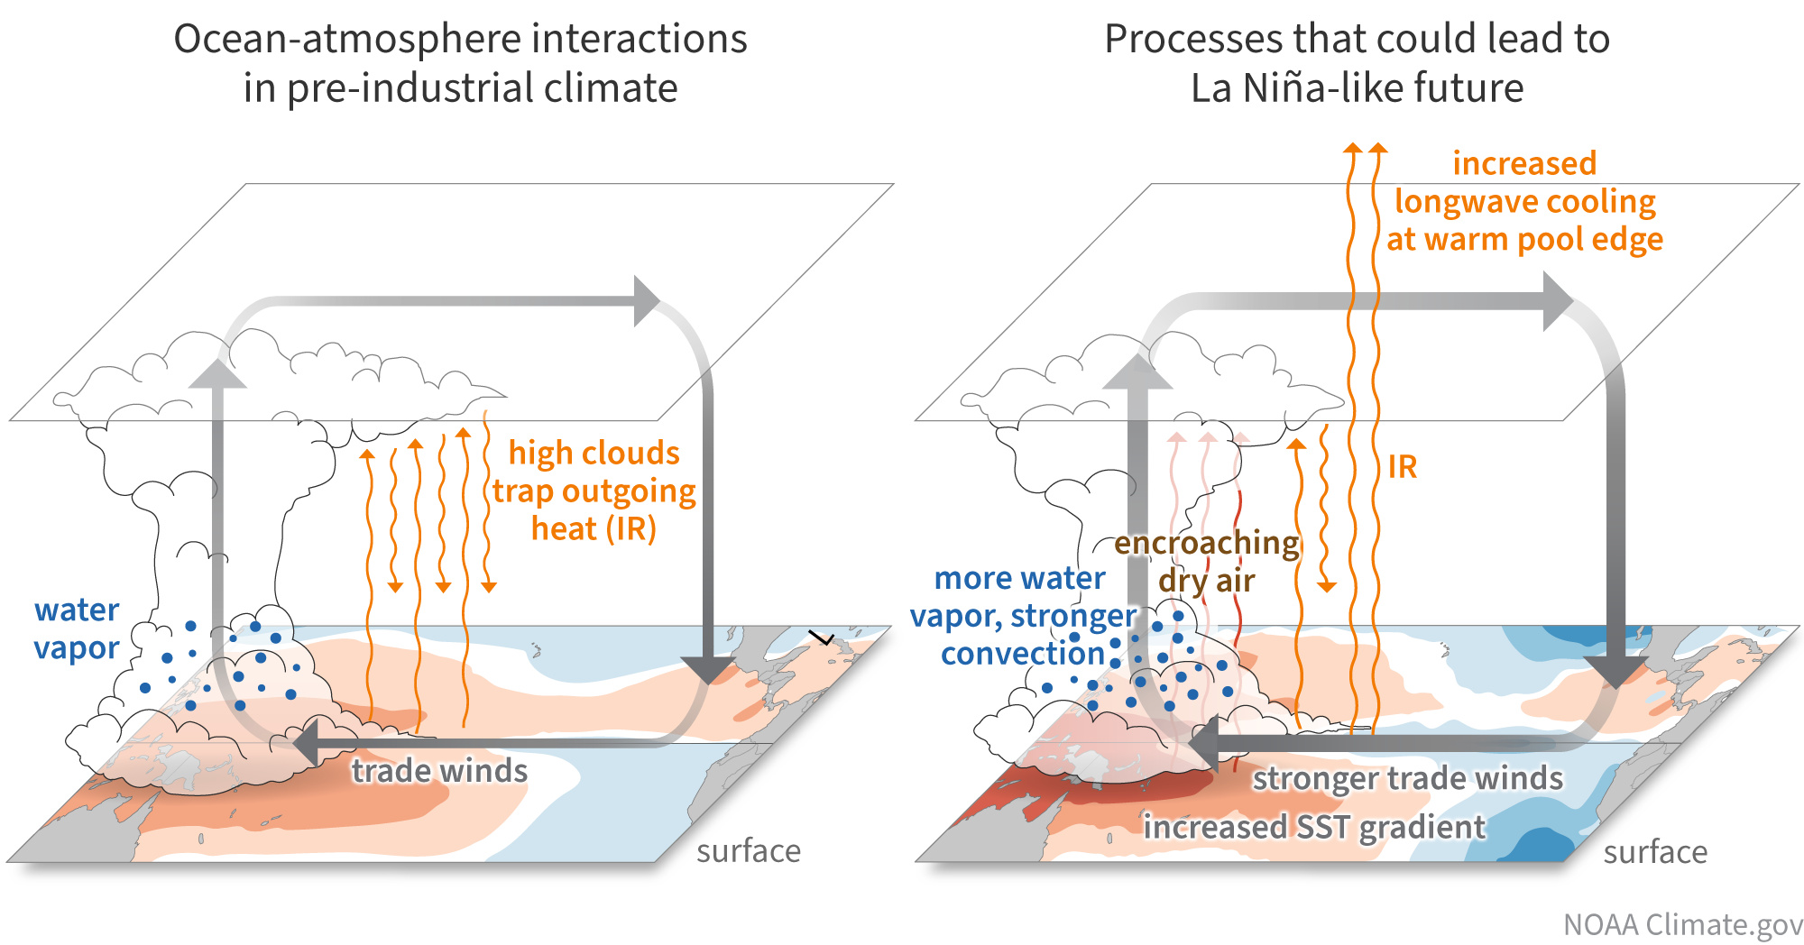
Mechanisms of equatorial Pacific climate change
Lee et al. (npjCAS 2022) & Climate.gov ENSO blog
Focus on eqPac biases in CGCMs
Future tropical Pacific climate, ENSO, & global impacts depend on a subtle balance of coupled, multi-scale, intermittent, often nonlocal processes.
Unresolved physics in CMIP-class models: Clouds & convection, diurnal cycle, TIWs, shears & mixing, barrier layers, air-sea fluxes, … → Errors + coupled feedbacks → Model biases → Degrade initializations, forecasts, projections
Need a hierarchy of coupled model tools to:
- Attribute emergent coupled biases
- Guide TPOS sampling to actually improve CGCMs
- Test new parameterizations in coupled/global context
- Identify where empirical corrections could help

Slide 5
GFDL project: Understanding eqPac climate processes via hierarchical coupled modeling
Objectives
1. Improve the diagnostic hierarchy for eqPac biases in CGCMs.
2. Advance understanding of eqPac’s role in climate & ENSO, and of coupled nonlocal feedbacks across scales (diurnal, TIW, S2S, ENSO, TPDV, mean, future change).
3. Attribute & reduce biases in NOAA/GFDL CGCMs & products, via better eqPac physics (mixing, fluxes, convection, clouds), bias corrections, and emergent constraints.
4. Inform the TPOS strategy. Provide broad-scale context for TPOS “regime-based” sampling, and target obs to inform CGCMs and their products (reanalyses, S2D forecasts, projections).

Slide 6
GFDL project: Understanding eqPac climate processes via hierarchical coupled modeling
Approach
Hierarchy of - Simulations: resolution, coupling, obs constraints (global & regional) - Metrics: heat/momentum/moisture/salt/mixing budgets; CLIVAR ENSO metrics - Reference datasets: obs, reanalyses, LES & high-res sims from prior TPOS studies
Main modeling tools:
- GFDL SPEAR & CM4 global CGCMs: large ensembles (1850-2100) & reforecasts Resolution: 1°A, 1°O → 0.25°A, 0.25°O Free, nudged, and bias-corrected (FA, OTA) Assimilation-initialized & model-analog forecasts
- GFDL MOM6 OMIP2: Global, regional, and 1d single-column versions
- GFDL ECDA (Ensemble Coupled Data Assimilation) System

Slide 7
GFDL project: Understanding eqPac climate processes via hierarchical coupled modeling
Relevance & Broader Impacts
- TPOS process studies & backbone design → better observations
- Better scientific understanding
→ better parameterizations, bias corrections, CLIVAR ENSO Metrics → better CGCMs
- GFDL SPEAR model + ECDA → NMME → seasonal-to-decadal forecasts
- GFDL-CM5/ESM5 models → CMIP7 → IPCC projections

Slide 8
GFDL project: Understanding eqPac climate processes via hierarchical coupled modeling
Recent Progress
- Completed SPEAR free & FA ensembles (1851-2100, 30 members each) - Atm/ocn resolution affects clouds, convection, rain, TIWs, mixing → ENSO - FA improves troPac climate & ENSO → boosts future ENSO rain extremes - Bias corrections (FA/OTA) improve SPEAR ENSO forecasts
- MOM6 OMIP2 tests (1d, regional, global) vs. Argo & LES - Stratified shear-driven mixing (Jackson et al. 2008) - ePBL ocean boundary layer mixing + convection + Langmuir (Reichl & Li 2019) - Refined vertical layers (Δz*) → smoothes mixing variations in warm pool - Weaken equatorial bkgd z-viscosity, ePBL mixing, submeso MLE restrat → Much better diurnal cycle & near-surface stratification - Strengthen equatorial background z-diffusivity → deeper thermocline - MOM6-1d with GOTM GLS mixing reproduces LES → valuable reference model!
- Finalizing & analyzing SPEAR_HI_25 (0.25°A, 0.25°O)

Slide 9
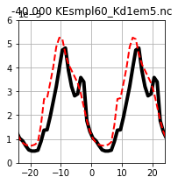
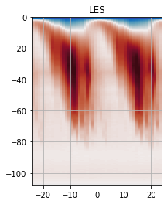
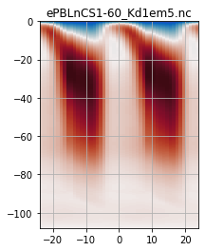
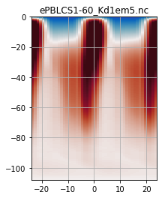
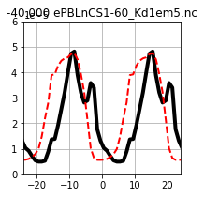
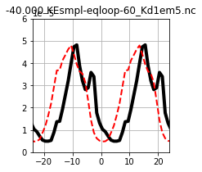
ePBL changes → Better eqPac upper-ocean diurnal cycle
from Brandon Reichl (AMS, Jan 2023)
LES & MOM6-1d simulations on equator at 140°W, forced by 8xdaily JRA55-do & ROMS, ~30 days
Diurnal composite of downward heat flux (red=down) over full simulation
Scheme w/ d(TKE)/dt
MOM6-1d OM4
OM4-revised
@40 m
Whitt et
al. (2022)
LES
The phase-shift is linked to using a steady-state equation for TKE!
5E-5
10⁻⁵[℃ m/s]
@40 m
Depth [m]
Depth [m]
Depth [m]
Temperature Flux [℃ m/s]
0
Scheme w/o d(TKE)/dt
10⁻⁵[℃ m/s]
@40 m
10⁻⁵[℃ m/s]
-5E-5
LES
Hours from Solar Noon
Hours from Solar Noon
Hours from Solar Noon
Hours from Solar Noon
Hours from Solar Noon
- OM4-revised corrects the problematic ePBL mixing → more realistic diurnal cycle
- Phase-shift in downward propagation of turbulent fluxes remains → ongoing work

Slide 10
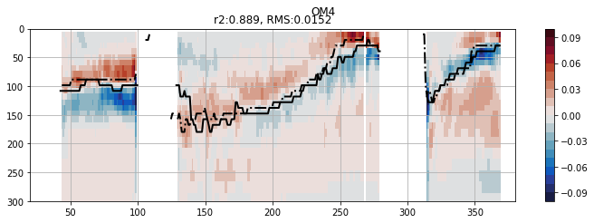
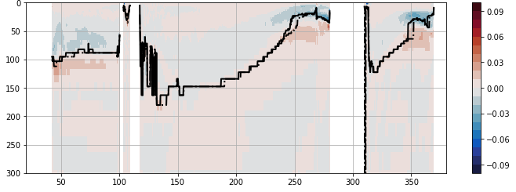
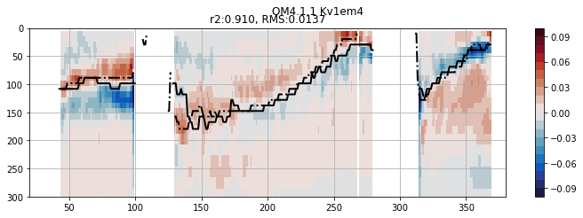
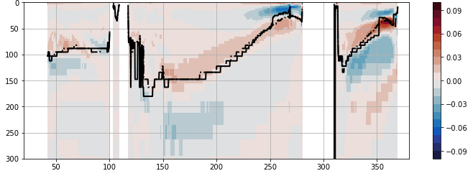
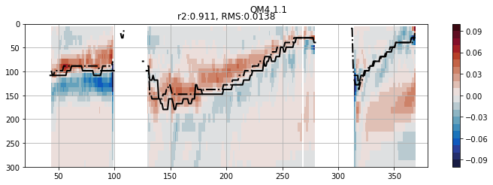
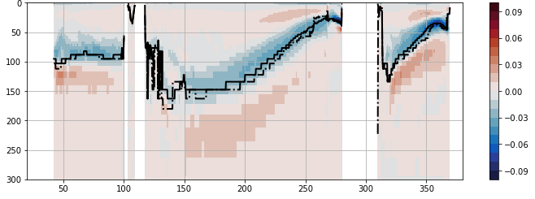
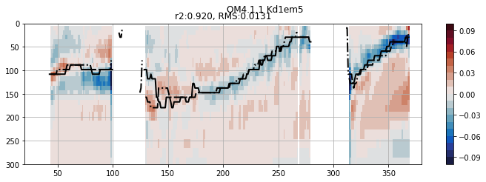
Mixing changes → Better eqPac dT/dz
from Brandon Reichl (AMS, Jan 2023)
0.25° MOM6 global OGCM
(forced by 8xdaily JRA55-do, 1999-2008)
Equatorial slice for upper 300m of ocean
Shallow &
“steppy”
thermocline
Simulated dT/dz bias [°C/m]
relative to Argo (1999-2008)
Original
OM4
Impact of parameterization change
Better ePBL mixing (better diurnal cycle)
10x less background
vertical viscosity
(stronger shears)
2x more background
vertical diffusivity
Reduced
equatorial
biases

Slide 11
GFDL project: Understanding eqPac climate processes via hierarchical coupled modeling
Next Steps
- Test/tune ocean mixing improvements in global coupled SPEAR
- Finalize SPEAR_HI_25
- Monthly CVP/TPOS PI meetings
Also meet with NCAR team (Deppenmeier, Cherian, Bryan) on 21 Feb
- Postdoc Xian Wu starts at GFDL on 13 March
→ Gather/process reference & simulation datasets
→ Spin up on literature, theory, models, diagnostics
→ Start analyzing eqPac heat budgets (mean, diurnal, TIW, ENSO)

