Slide 1
ENSO Metrics: Status & Next Steps
Presented by Andrew Wittenberg
with contributions from
Yann Planton, Jiwoo Lee, and the ENSO Metrics Team
CLIVAR Pacific Region Panel Meeting, 13 February 2023

Slide 2
ENSO Metrics: Background
CLIVAR Research Focus: ENSO in a Changing Climate http://www.clivar.org/research-foci/enso 2014-2018; then merged back into CLIVAR PRP Co-chairs: E. Guilyardi (IPSL) & A. Wittenberg (NOAA GFDL) Implementation & application: Yann Planton (IPSL/PMEL) 12 ENSO experts (France, US, Australia, Japan, Korea, UK)
Goals: - Understand ENSO processes & past/future changes - Develop evaluation protocol for ENSO in GCMs - Target obs to improve models & projections
ENSO Performance: Andrew, Yann, Antonietta, Mike, Matt, Scott, … Teleconnections: Scott, Yann, Shayne, Cai, … Processes: Yann, Eric, Soon-Il, Fei-Fei, Tobias, …
Community package liaisons: PMP: Jiwoo Lee & Peter Gleckler (PCMDI) ESMValTool: Veronika Eyring (DLR); Bryan Lawrence (NCAS); Barcelona (BSC) CliMAF: Jérôme Servonnat (IPSL)

Slide 3
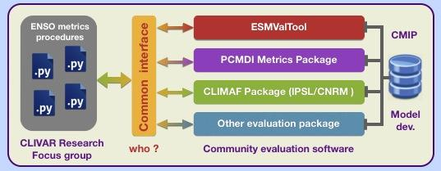
ENSO metrics strategy
Start with a small subset of essential, simple metrics. Avoid getting bogged down with complexity Aim more at model users than model developers. Expand as code, interfaces, use-cases take shape.
Metrics (scalars) are first step in a diagnostic hierarchy Useful for intercomparing models & metrics Dive-down diagnostics: Scalar → 1d → 2d → 3d Want to see both “forest” and “trees”.
Account for: - Internal variability (multiple historical ensemble members) - Obs uncertainties (use multiple obs products, epochs)
Written in Python Powerful, flexible Plugs into community efforts

Slide 4
Metric Requirements
1. Documentation: Whys & hows of metric and collection
2. Math definition of metric (positive scalar “distance”)
3. Input data frequency (monthly, daily, ...) and grid (1x1 lat/lon, region, etc.)
4. Obs (as many as possible) and epoch to use
5. Literature reference to show robustness/utility of metric
6. Sample size (duration or ensemble) needed for metric to make sense
7. Dive-down diagnostics (e.g. the spatial maps used to compute RMSE)
8. Normalization to use for multi-model intercomparison (single color bar)

Slide 5
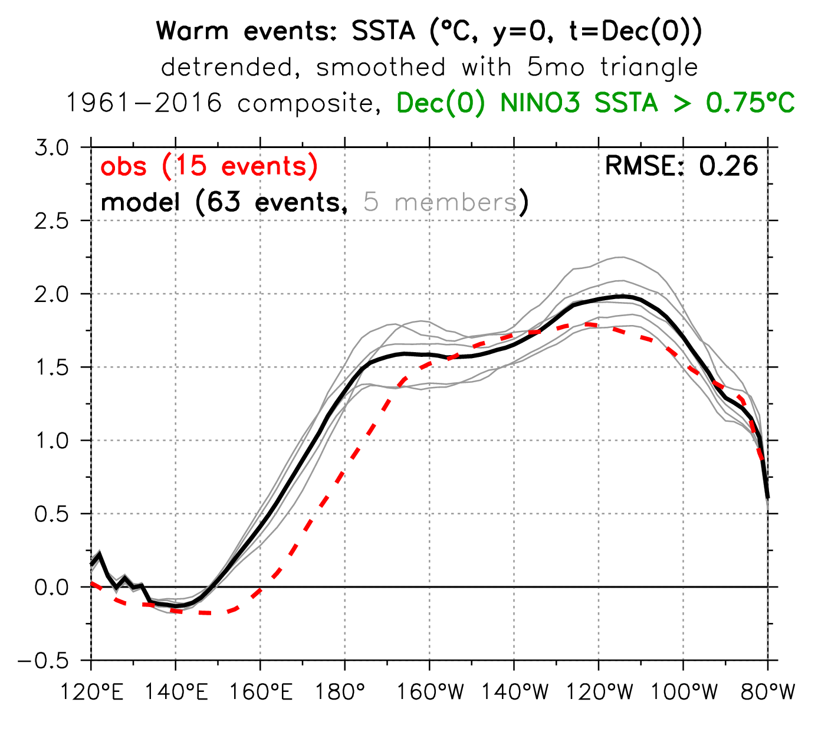
metric
double peak
diagnostic
SSTAs extend too far west

Slide 6
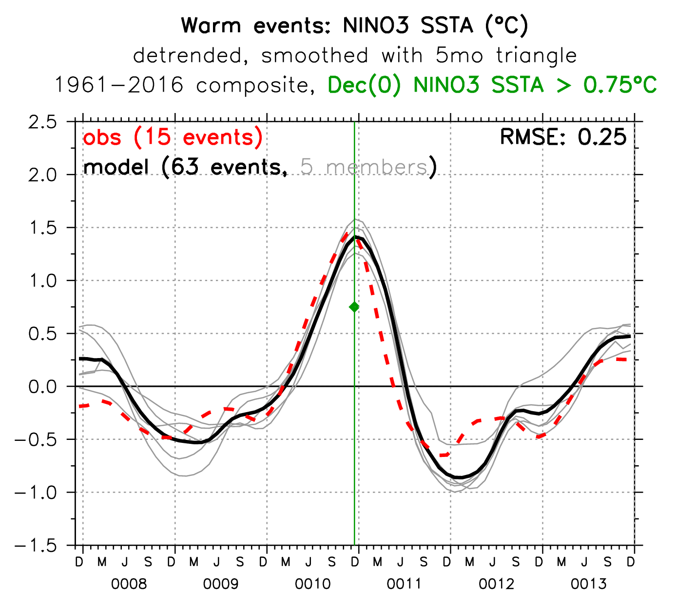
delayed termination
Inter-EN spacing
EN duration
ENSO lifecyle
Inter-LN spacing
excessive overshoot

Slide 7
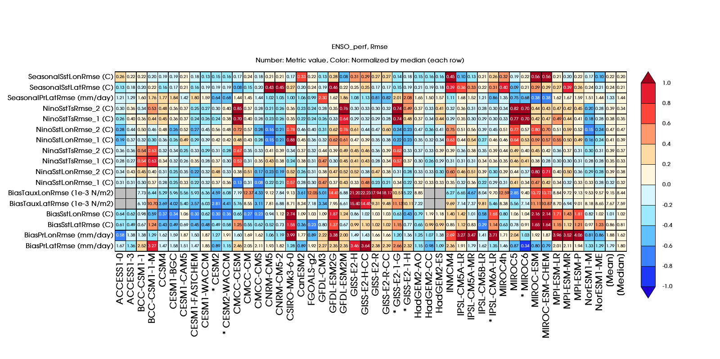
ENSO performance
RMSE-based metrics
Colors: relative to median value of metric (last column)
Numbers: metric value
colors:
medians
from
inter-model
median
metrics
numbers: RMSE relative to obs
(perfect score is 0)
worse
median model
better
different
composite
thresholds
models
* = CMIP6

Slide 8
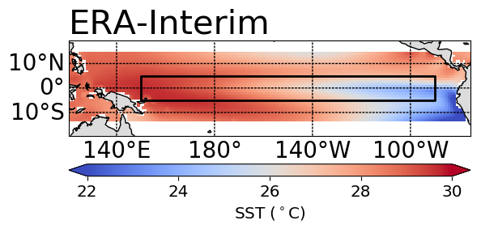
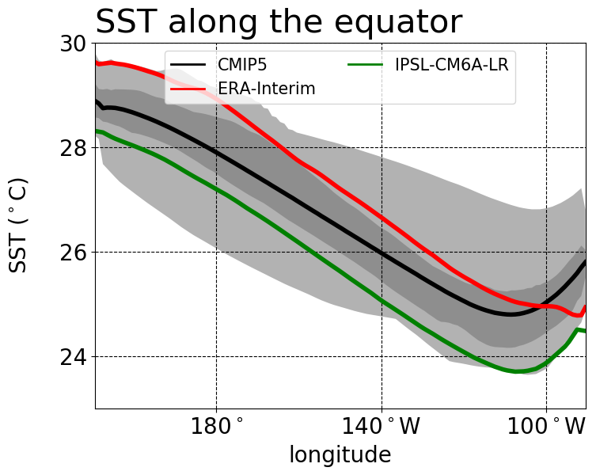
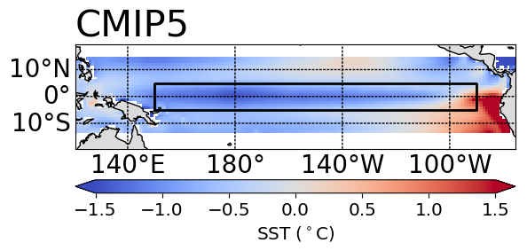
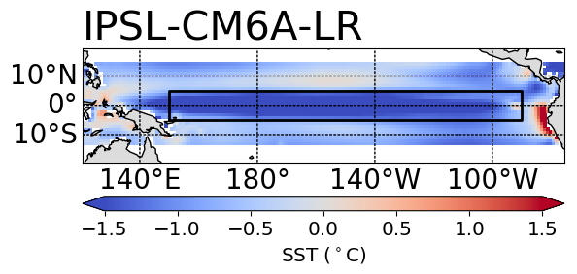
Dive-down diagnostics:
Annual-mean SST
Dive-down level 2:
Metric:
RMSE(obs, model)
IPSL-CM6A-LR = 1.6°C
Dive-down level 1:
(5°S-5°N)
IPSL-CM6A-LR
too cold everywhere

Slide 9
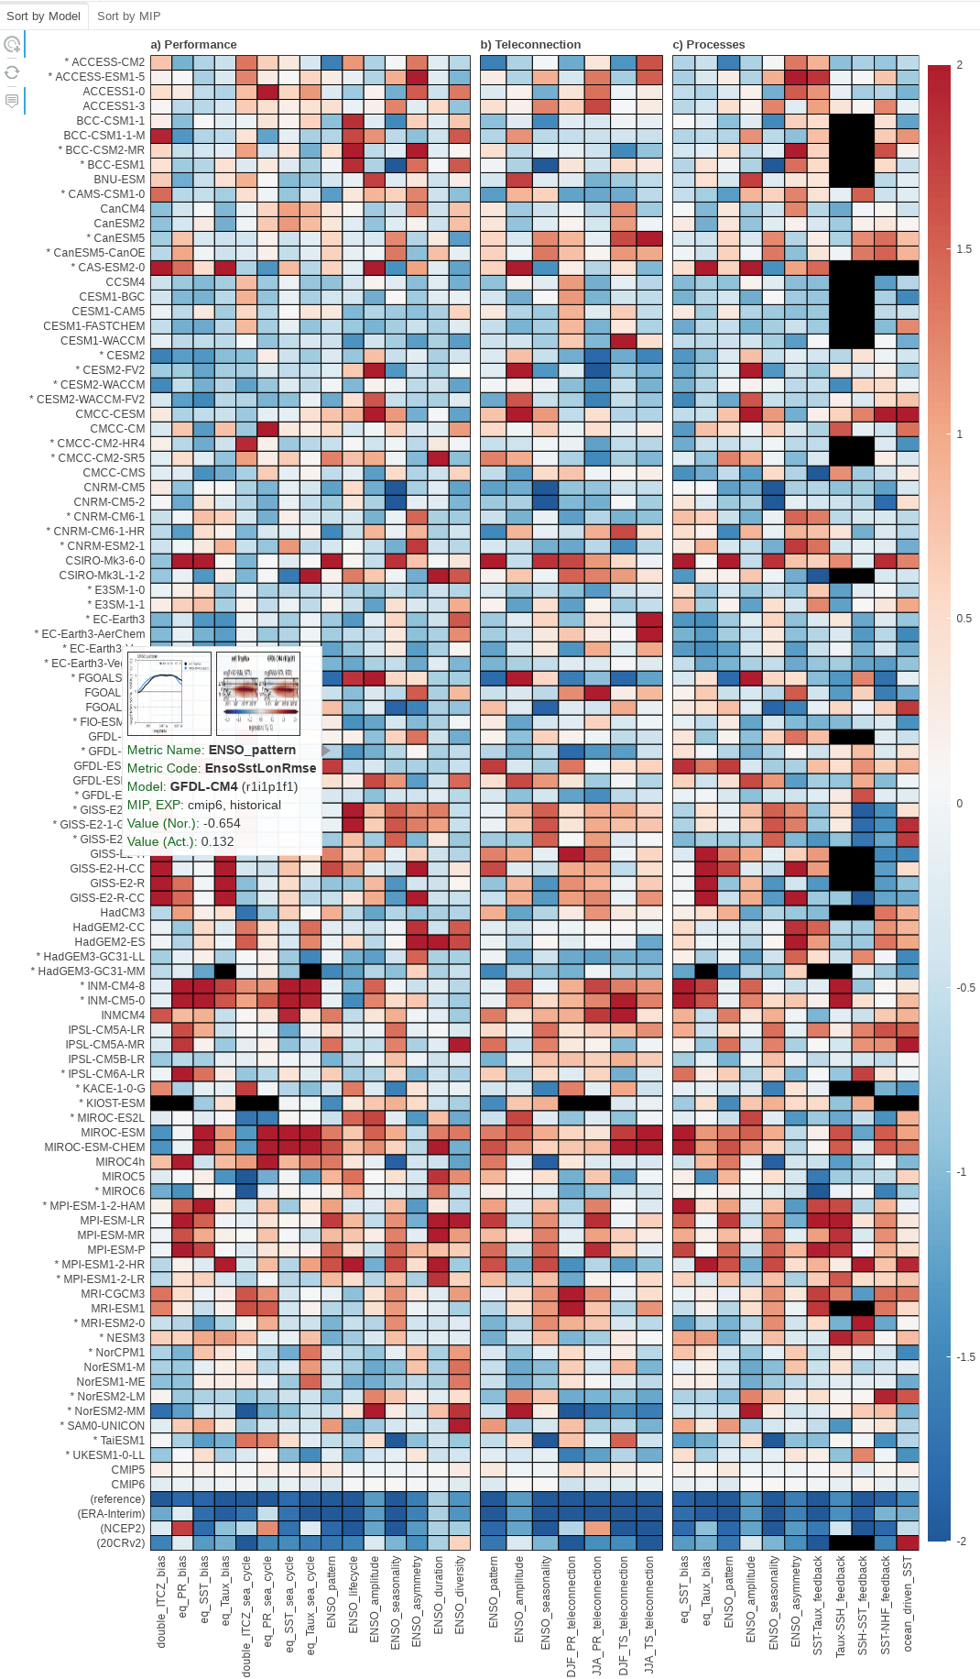
ENSO Metrics:
Public Release & Documentation
Planton et al. (BAMS 2021)
“Evaluating climate models with the CLIVAR 2020 ENSO metrics package.”
- Documents & demonstrates the package
- CMIP6 models mostly outperform CMIP5,
except for some process metrics
(e.g., the h → SST coupling worsened)
CMIP5/6 ENSO Metrics summary https://pcmdi.llnl.gov/research/metrics/enso
- Interactive dive-down diagnostics
- Pre-computed model metrics for download
(JSON & Excel)
Wiki: https://github.com/CLIVAR-PRP/ENSO_metrics/wiki
Software: https://github.com/CLIVAR-PRP/ENSO_metrics

Slide 10
Recent studies using the ENSO Metrics Package
Lee et al. (GRL 2021): “Robust evaluation of ENSO in climate models: How many ensemble members are needed?” - For CMIP5/6 & LEs, need N ≥ 50 to constrain ENSO baseline & process metrics - Less for climatology (N ≥ 6) & ENSO teleconnections (N ≥ 12) for 95% of N-ensemble means (of 1979-2018 metrics) to fall within 10% of actual mean metric
Xu et al. (JC 2022): “The Andes affect ENSO statistics” - Elevate the Andes to more realistic levels in CESM_1.2.2 → better (more LN-like) troPac climate → weaker ENSO; more asymmetric, irregular, evaporatively-damped
Planton et al. (in prep for JAMES): “Detecting ENSO variance changes in a warmer world.” - CMIP6 historical runs: Sample size to detect past & future ENSO amplitude changes? Need 5 – 9 members, for ensemble-mean 30yr variance to fall within 15% of actual long-term variance - If ENSO strengthens → more decadal modulation → later detection - Quiet/hyperactive ENSO decades can aid earlier detection
Lee et al. (in prep for GMD): “Diversifying objective summaries of Earth system model performance: An overview of the PCMDI Metrics Package (PMP).” - A section is devoted to the ENSO metrics

Slide 11
Community Connections
CLIVAR/ICTP ENSO Summer School Yann Planton developed & ran student tutorials, applying package to CMIP6 → supported the WCRP Academy Lighthouse Activity (LHA)
Jiwoo Lee joined the CMIP7 Climate Model Benchmarking Task Team → Actively promoting the CLIVAR ENSO Metrics via the PMP framework
Connections with other community efforts PMP, ESMValTool, CliMAF, MDTF ES-Doc & Comparator: model resolution, lineage, parameterization schemes
Tropical Pacific Observing System (TPOS) Obs targeting + new reference data

Slide 12
Next Steps for ENSO Metrics
Leverage recent enhancements - Added more obs datasets to test robustness (Planton et al., in prep) - Index statistics: mean, stddev, skewness, d.o.f. → significance - Wait times between ENSO events: mean, stddev, skewness, PDFs, transition probabilities
New metrics in development - ENSO regional teleconnections: regressions, composites (per McGregor et al. 2022) - New ENSO process metrics (per Chen et al. JC 2021) BWJ indices, ML heat budget, nonlinear dynamical heating (NDH) - Model-analogs as metrics of ENSO evolution, predictability, forecast skill Applied to NMME & CMIP5 historical: Ding et al. (JC 2018; GRL 2020) Applied to CMIP6 & LE, historical & future: Lou et al. (subm. & in prep.) + ongoing work at NOAA PSL & GFDL - CLIVAR PRP Working Group on Conceptual Models of ENSO
New & proposed projects: - Impact of climate change on ENSO (Planton, Lee, et al., in prep) - EqPac upwelling & mixing in CGCMs (Wittenberg et al., NOAA CVP), funded 2023-25 - Dynamical ENSO metrics & emergent constraints (Jin et al., NOAA MAPP), submitted

Slide 13
Action Items for PRP
1. Feedback on metrics, interfaces, development, dissemination
2. Recommend observational references - Latest gridded products, reanalyses - How to best characterize obs uncertainties? - Best epochs to use?
3. Recommended realizations for model & obs (epochs, ensemble sizes)
4. Ideas for new metrics - Expand existing collections: e.g. connect to conceptual models - New collections: Climate change, teleconnection processes, impacts, …
5. Ideas for applications & tiering of metrics - Model evaluation & selection/weighting - Physical links among metrics; emergent constraints for future change
6. Resources: Postdocs, web/data techs, funding opportunities, ...

Slide 14
Reserve Slides

Slide 15
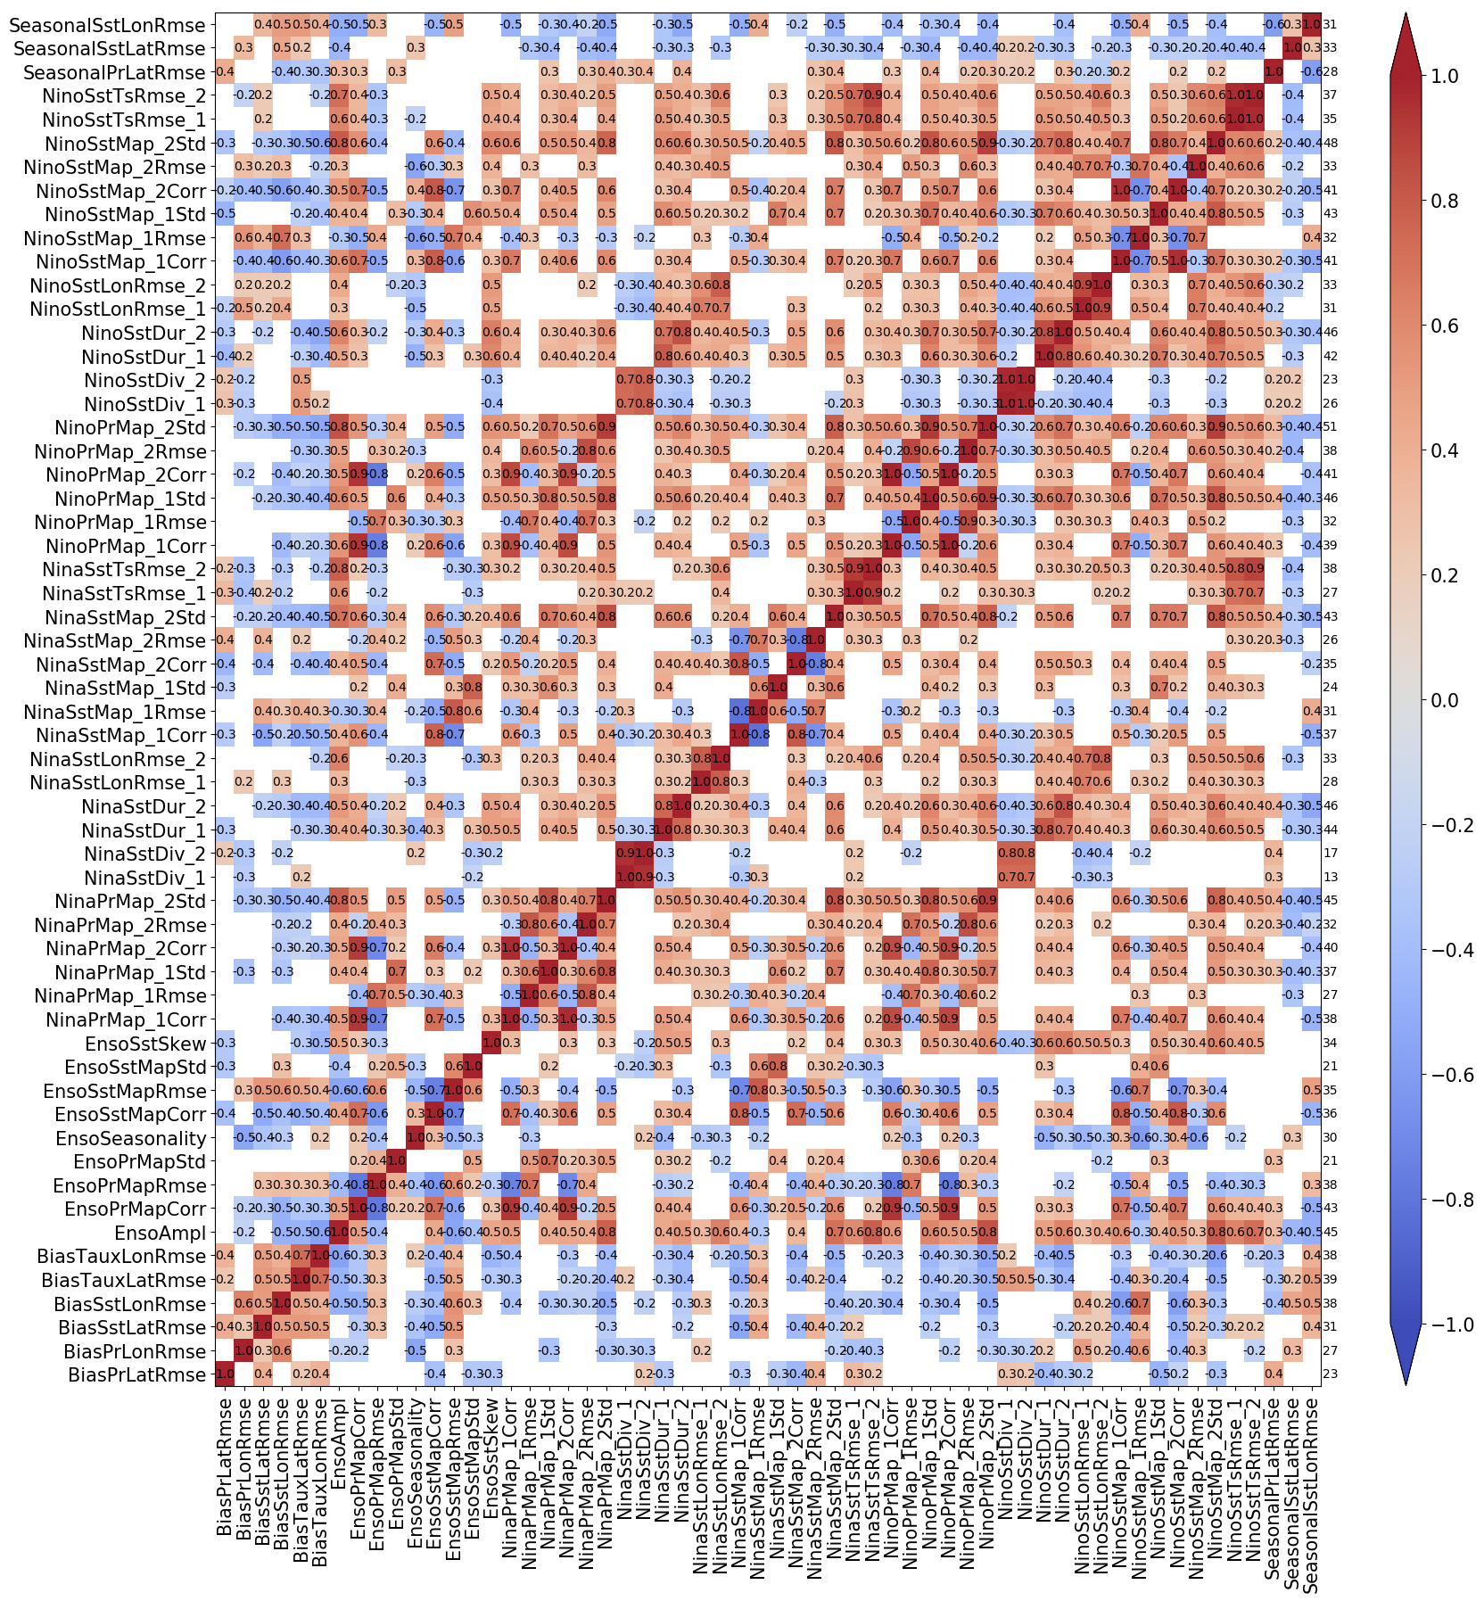
Discovering links among metrics
correl(metric₁, metric₂)
Compute correlations & EOFs across CGCMs, to identify redundancies → cull the metrics.
Findings:
- ECT cold/dry biases affect ENSO patterns & feedbacks
- h → SST feedback anticorrel with other feedbacks
Can inform conceptual modeling!
← correlate metrics across the models →

Slide 16
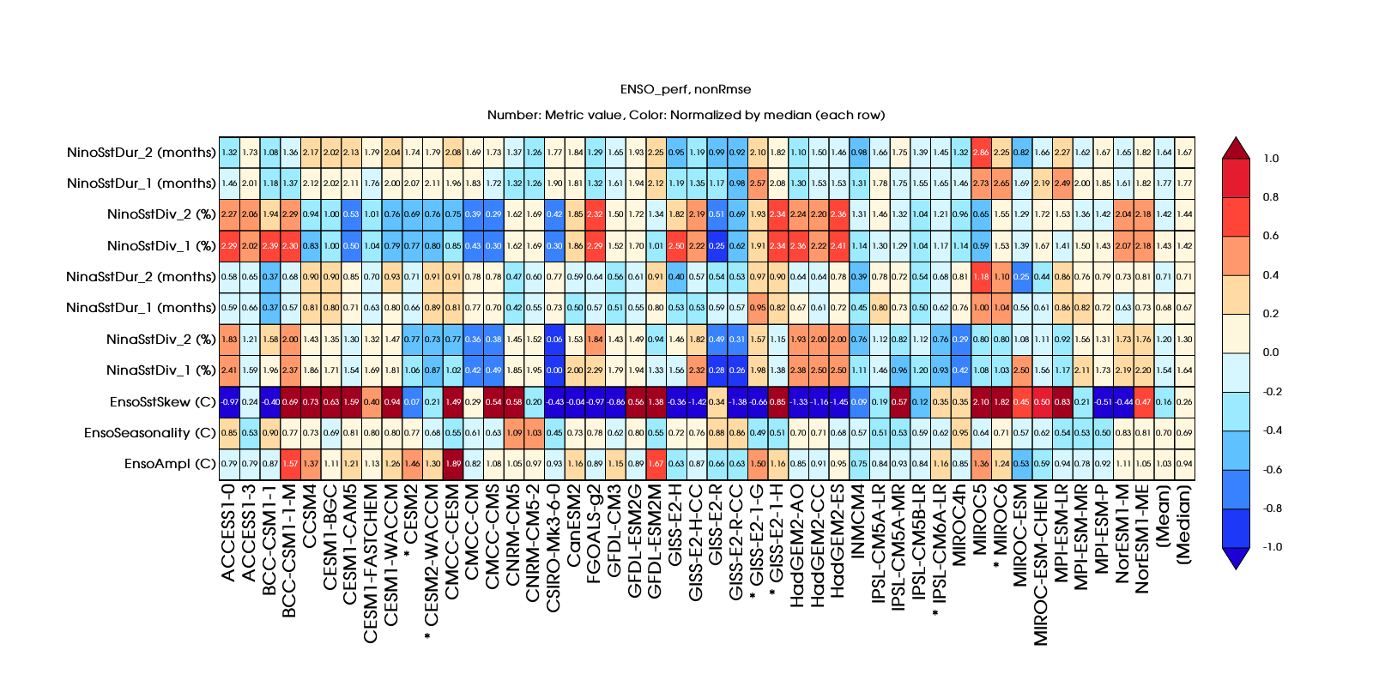
ENSO performance
Non-RMSE-based metrics
Colors: relative to the median value of the metric (last column)
Numbers: ratio of model to obs value
colors:
medians
from
inter-model
median
metrics
numbers: model/obs
(perfect score is 1)
more
median model
less
models
* = CMIP6

Slide 17
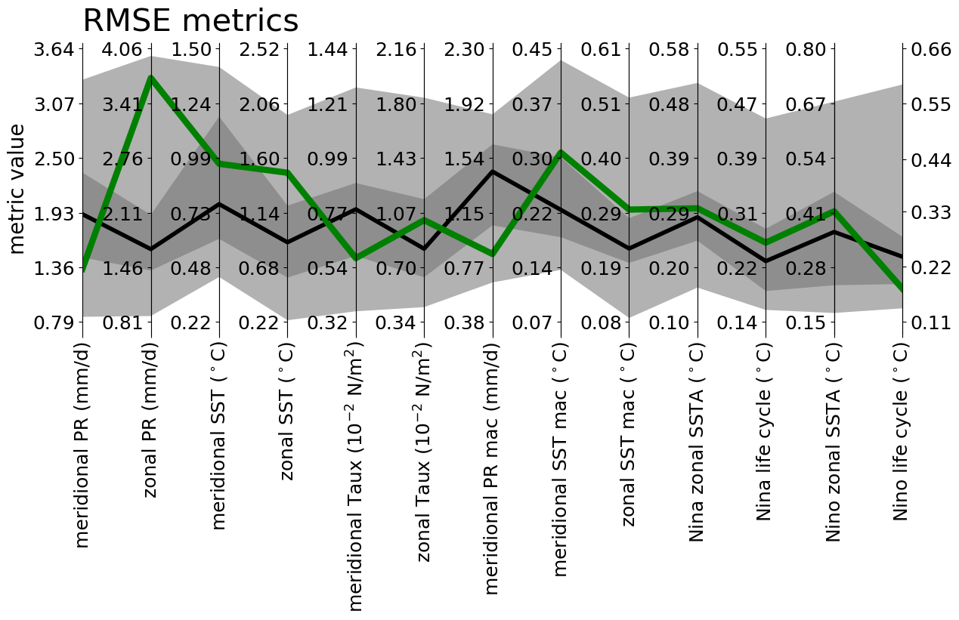
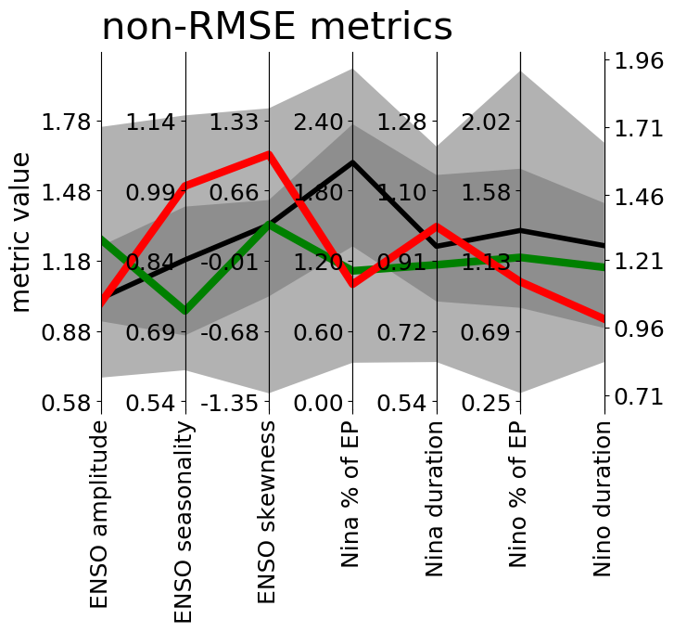
ENSO performance
Parallel coordinate plot: Multi-metric performance relative to CMIP distribution
Example of use for IPSL-CM5A-LR, vs. CMIP5 (shading) and Obs

Slide 18
Historical ENSO (63 metrics)
Properties (3)
EnsoAmpl (K)
EnsoSeasonality (K)
EnsoSstSkew (K)
Composite patterns & evolution (for warm & cold events; 16 in total)
NinoSstDur (months)
NinoSstDiv (%), IQR of diversity relative to obs
NinoSstLonRmse (K), along equator
NinoSstTsRmse (K), for NINO3 life cycle
Teleconnections (38)
EnsoAmpl
EnsoSstLonRmse (K): zonal SSTA pattern (5S-5N)
NinoMap_Rmse (outside eqPac, for warm & cold events)
variables: SSTA, SLPA, precip anom
statistics vs. NINO3.4: regression, correlation, ratio of stddevs → Taylor diagram
Processes / feedbacks (6)
EnsoAmpl
EnsoFbSstTaux: SST → tau_x
EnsoFbSstThf: SST → heat flux
EnsoSstOce: role of ODC in SST change
EnsoFbSshSst: SSH → SST
EnsoFbTauxSsh: tau_x → SSH feedback
monthly data, MKS units,
CMIP variable names,
auto-regridded to 1°x1°

Slide 19
Historical Climatology (9 metrics)
Annual mean (6)
Equatorial Pacific (5S-5N)
BiasSstLonRmse (K)
BiasPrLonRmse (mm/day)
BiasTauxLonRmse (mPa)
EPac meridional structure (15S-15N)
BiasSstLatRmse (K) (140W-110W)
BiasPrLatRmse (mm/day) (140W-110W)
BiasTauxLatRmse (mPa) (150E-90W)
Seasonal cycle (3)
SeasonalSstLonRmse (K)
SeasonalSstLatRmse (K)
SeasonalPrLatRmse (mm/day)

Slide 20
Metrics Collections (after culling)
ENSO performance (16)
Mean state biases (6): BiasPrLatRmse, BiasPrLonRmse, BiasSstLatRmse, BiasSstLonRmse
Annual cycle biases (3): SeasonalPrLatRmse, SeasonalSstLatRmse, SeasonalSstLonRmse
ENSO stats (4): EnsoAmpl, EnsoSeasonality, EnsoSstSkew, NinoSstDiversity
ENSO regression (3): EnsoDuration, EnsoSstLonRmse, EnsoSstTsRmse
ENSO teleconnections (11):
ENSO stats (1): EnsoAmpl
ENSO regression at Eq.(1): EnsoSstLonRmse
ENSO precip reg. (3): EnsoPrMap x3 (RMSE, corr. and spatial variability ratio)
ENSO SPL reg. (3): EnsoSlpMap x3 (RMSE, corr. and spatial variability ratio)
ENSO SST reg. (3): EnsoSstMap x3 (RMSE, corr. and spatial variability ratio)
ENSO processes (6):
ENSO stats (1): EnsoAmpl
Taux-SST feedback (1) EnsoFbSstTaux
HF-SST feedback (1) EnsoFbSstThf
SST change origin (1) EnsodSstOce
SSH-SST feedback (1) EnsoFbSshSst
Taux-SSH feedback (1) EnsoFbTauxSsh
Reduced from 72 metrics down to 33.

Slide 21
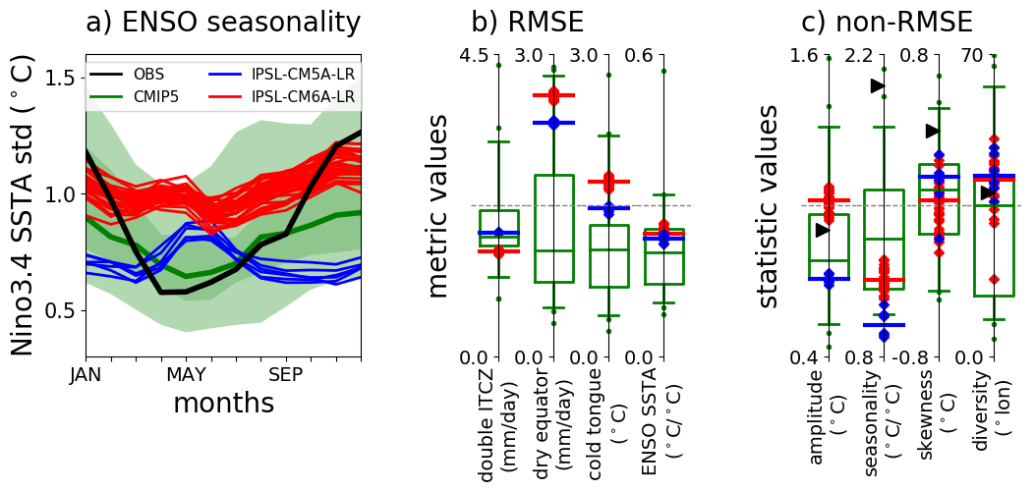
Example of use: IPSL model eval.
Historical CMIP5 vs. CMIP6 (7 / 32 members)
NINO3.4 SSTA
bad
obs
strong
good
weak
Diversity of El Nino events
(5mo running mean Dec NINO3.4 SSTA >0.75K):
IQR of distrib of peak SSTA lons along eq

