Slide 1
GFDL: Toward seamless prediction across time & space scales
Drivers & Goals:
Benefits of a seamless system for prediction and understanding across time and space scales
Applied to wide range of phenomena, from very short time scales to decadal and beyond
Increased understanding that leads to improved predictions
Outline:
Current system for prediction across time scales – design and accomplishments
Next generation prediction system – “SPEAR”

Slide 2
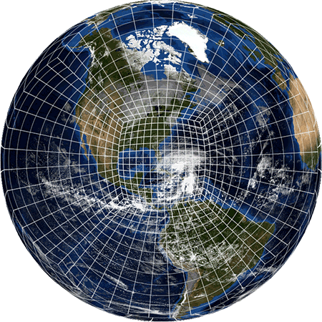
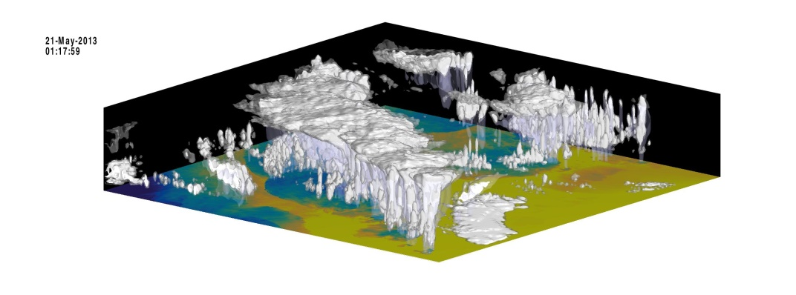
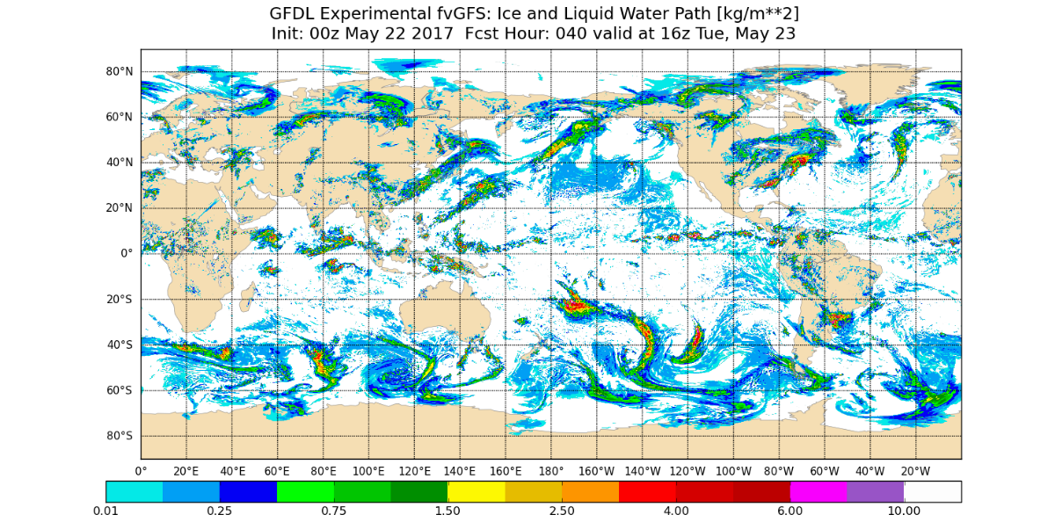
Activities on shorter timescales:
Global-to-regional Refinement
(two-way nesting, or stretching)
Consistent, rapid interaction
Improved BCs
Large-scale interaction (great for TCs)
Enables medium-range/S2S convective-scale prediction
An improvement upon existing models:
the key to next-generation CAMs
60–90 second
Two-way Interaction
Stand-alone Regional Model
Low computational overhead (ideal for resource-limited users)
Simple and easy (global modeling is HARD)
Good for extremely high resolutions (LES, urban-scale, Warn-on-Forecast)
  3-km is not the end!!
Three-hour
BC Update Frequency
Tom Black, EMC
Courtesy SJ Lin and L Harris

Slide 3
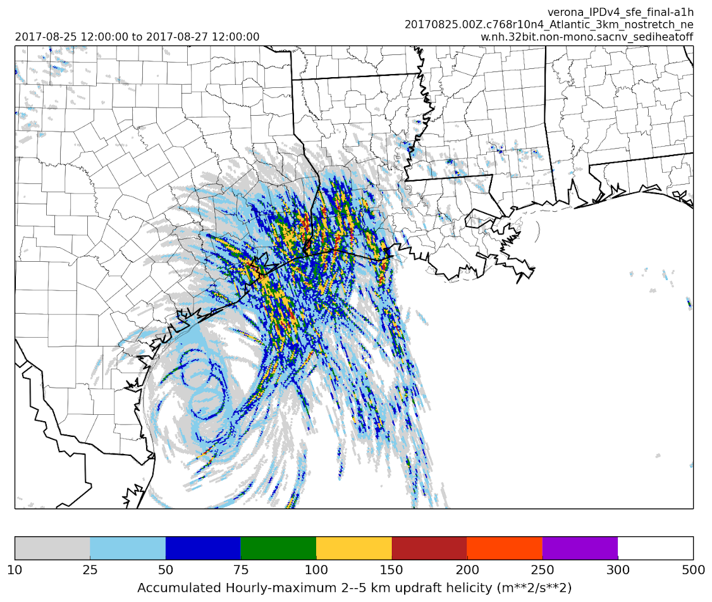
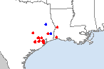
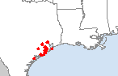
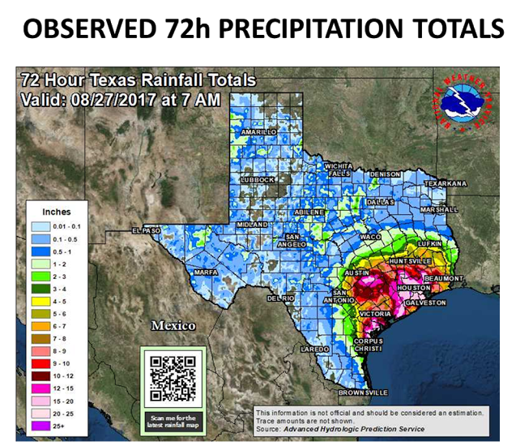
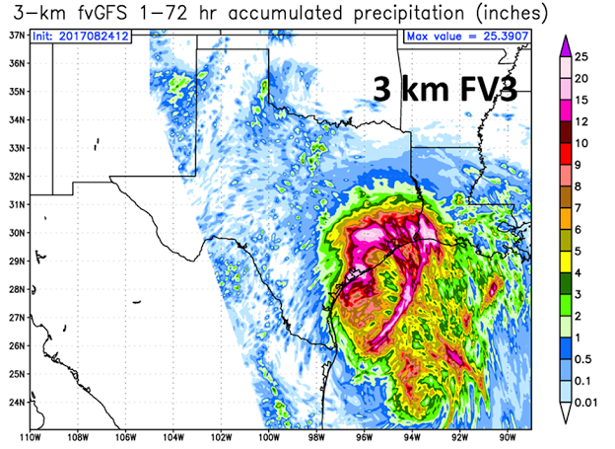
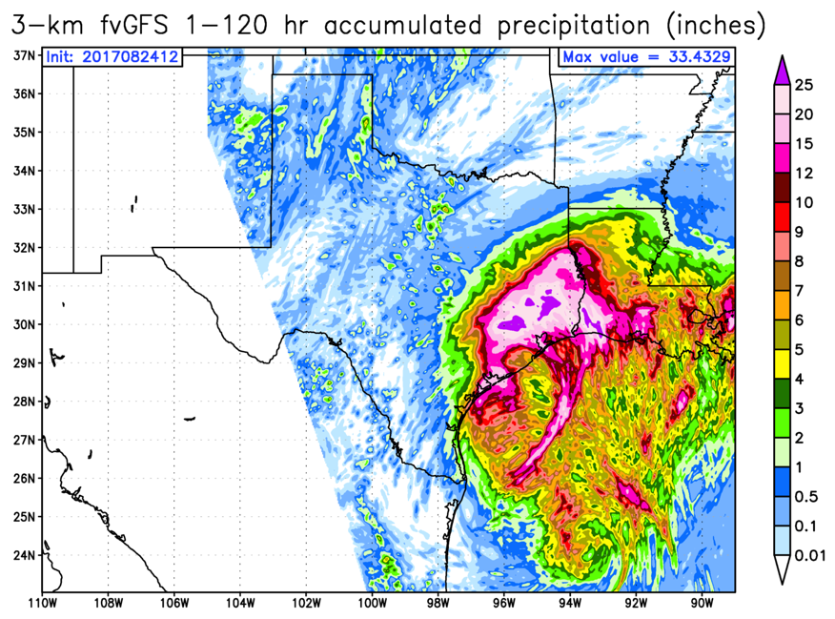
Hurricane Harvey: 3-km nested hfvGFS
SPC Reports
12Z 26–12Z 27 Aug 17
SPC Reports
12Z 25–12Z 26 Aug 17
12Z 25–12Z 27 Aug
Severe Proxy (max w x ζ )
Initialized 00Z 25 August
Init 12Z
24 August

Slide 4
Building a seasonal to decadal prediction system
1a. Develop coupled ocean-atmosphere-land-ice model
[thousands of simulation years]
1b. Develop initialization method
[thousands of simulation years]
DEVELOPMENT PHASE
2. Conduct sets of reforecasts
[10,000+ model simulation years for seasonal reforecasts]
TESTING PHASE
3. Assess skill adequacy from reforecasts
[0K or redo steps 1-3]
REAL-TIME PREDICTIONS
4. System can be used for real-time predictions (e.g. NMME)
CURRENT SYSTEM IN USE: CM2.1/FLOR/HIFLOR
NEW SYSTEM IN DEVELOPMENT: SPEAR

Slide 5
GFDL Seasonal to Decadal Prediction and Research Systems
 | Atmosphere resolution | Ocean resolution
CM2.1 | 200 km | 1º
FLOR | 50 km | 1º
HIFLOR | 25 km | 1º
CM2.1 and FLOR: run each month as part of the North American Multi-Model Ensemble (NMME)
Output provided to NCEP (National Hurricane Center and Climate Prediction Center) to inform their seasonal outlooks
  FLOR and HIFLOR¹ for hurricanes
  CM2.1 and FLOR for other climate outlooks, including precipitation and temperature
Ocean reanalysis also provided to NCEP for Multiple Ocean Reanalysis Project
Key point: These prediction systems are made possible through harvesting the fruits of a decades long research effort on INITIALIZATION SYSTEMS and MODEL DEVELOPMENT.
¹ Due to computational cost, HIFLOR is not run routinely

Slide 6
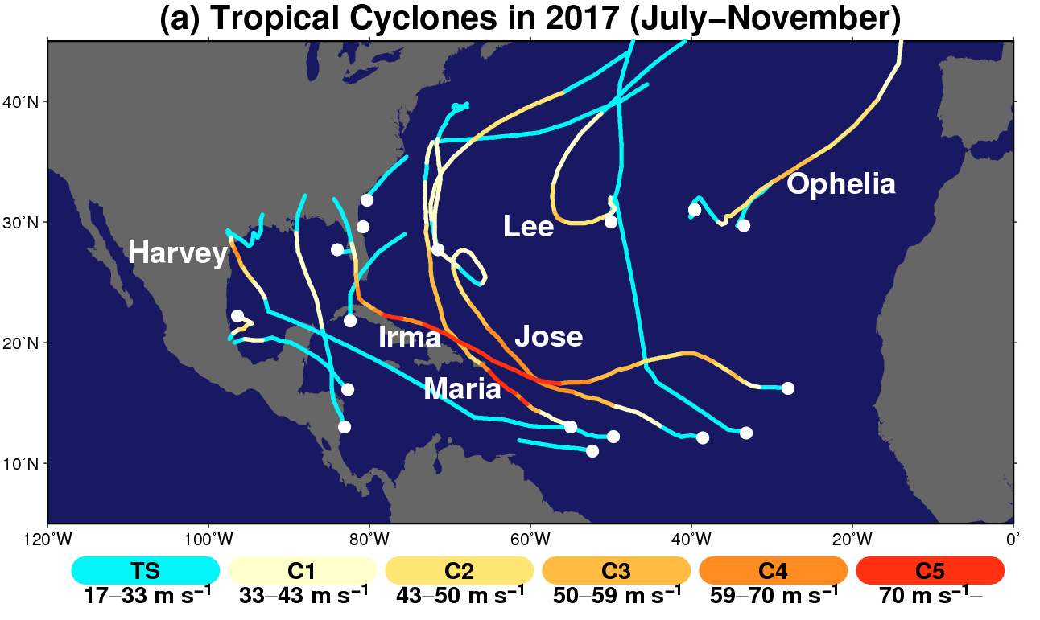
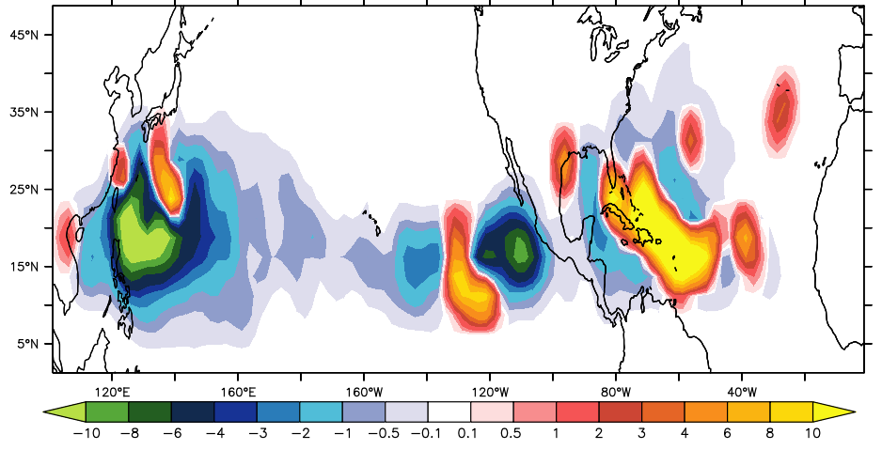
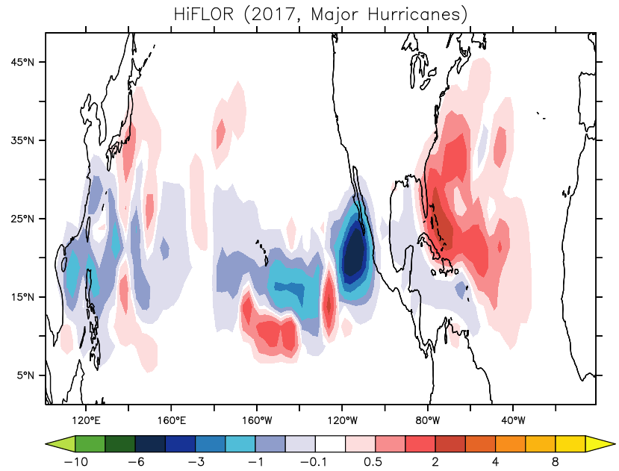
Real-Time Seasonal Hurricane Prediction for 2017 (Initialized 1 July, 2017)
Courtesy: Hiro Murakami
Observed Storm Tracks in 2017
A few months in advance, HiFLOR predicted an unusually large number of Atlantic Major Hurricanes for the 2017 summer.
Murakami et al., Science, 2018
Observed MH Density Anomaly
Predicted MH Density Anomaly

Slide 7
Towards a Seamless System for Prediction and EArth System Research
“SPEAR”
➔ Using latest generation component models to build next generation seamless prediction system.
The building blocks are AM4/FV3 (atmosphere), MOM6 (ocean), SIS2 (sea ice), LM4 (land)
Drivers:
Advances in scientific understanding, physics, and numerics
User needs for improved predictions across scales, especially for extremes and regional scales
 | Atmosphere resolution | Ocean resolution | Model Development Status | Reforecasts
SPEAR_LO | 100 km | 1º | Completed | Planned next 6-9 months
SPEAR_MED | 50 km | 1º | Completed | Planned next 6-12 months
SPEAR_HI | 25 km | 1º | In final development | Very limited set planned due to computational costs
Longer term plans for seamless prediction:
Higher resolution nonhydrostatic, with refined mesh for very high resolution predictions and extremes, especially over North America
Higher resolution ocean, especially for coastal processes
Incorporation of components from Earth System Model (biogeochemistry, carbon, marine ecosystems)

Slide 8
Towards a Seamless System for Prediction and EArth System Research
“SPEAR”
Additional critical component: Initialization systems!
Building new initialization systems using MOM6 and SPEAR model.
Near-term plans:
SPEAR_MED will be used for seasonal prediction as part of NMME
(planned transition in late 2019)
SPEAR_LO will be used for decadal prediction
Both models will be used in a variety of research applications
SPEAR_HI is in development, hopefully complete by Spring, 2019

Slide 9
EXTRA SLIDES

Slide 10
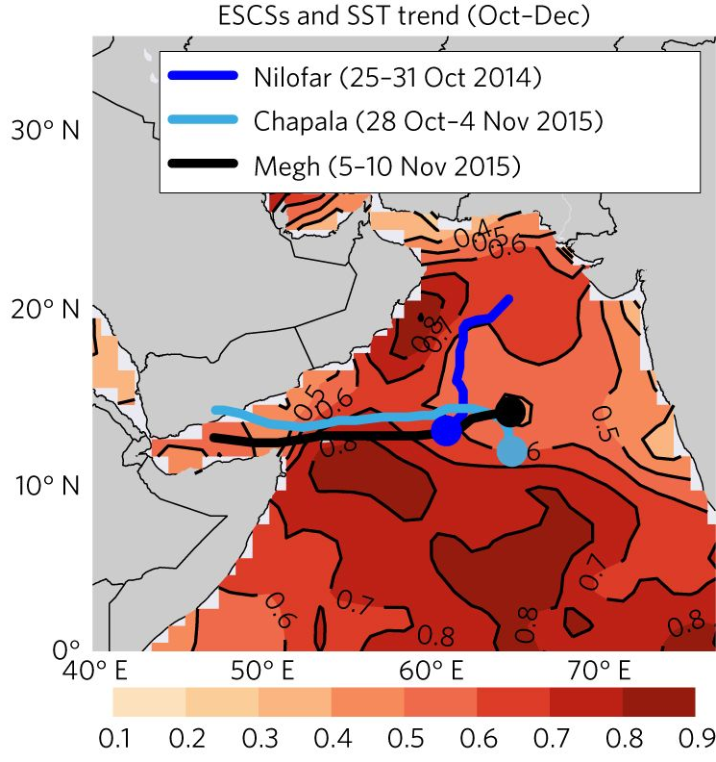
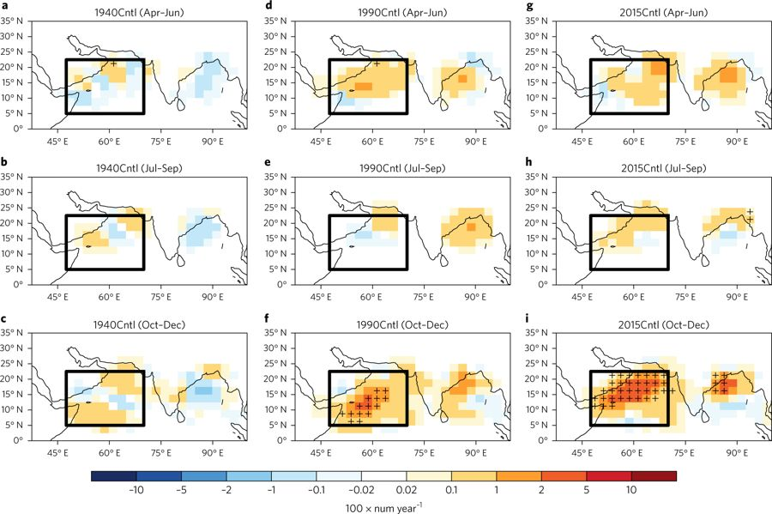
Seamless prediction systems may provide advance warning of emerging threats
Projected changes in SST and atmosphere lead to new threats of tropical storms in the Arabian Sea where previously there had been none.
1940
1990
2015
Color shading indicates observed trend in SST
Increasing frequency of extremely severe cyclonic storms over the Arabian Sea
Murakami et al, 2017, Nature Climate Change
Projected density of tropical storms in Oct-Dec (post-monsoon period) over Arabian Sea.

Slide 11
TRADEOFFS: Building the best prediction system given available computing resources
The table above shows how long it would take (in months) to complete a reforecast suite for three resolutions of an atmospheric model (100 km, 50 km, and 25 km) coupled to a 1º ocean model. The different columns make different assumptions about either the characteristics of the reforecast suite (duration of the reforecast, start months, or ensemble members) or the available computational resources to understand the viability of reforecast selections. Based on experience, a set of reforecasts that would take 5 or more months is not viable (these boxes are shaded in red). Such a long process would not allow for the normal iterative process that is necessary in the development of models and prediction systems. A box shaded in yellow is at the margins of viability.
The “Base Case” assumes 10% of the NOAA GAEA supercomputer system is used for a full suite of reforecasts producing 10,800 model simulation years.
An “alternative reforecast suite” (20 ensemble members and 20 years of reforecasts) makes a 50 km viable in addition to the 100 km model.
Altering computer resources (rightmost columns) and limiting the number of start months to quarterly improves the viability of higher resolution models.
NOAA currently allocates 74 million CPU hours per month on the GAEA supercomputer. In this document we refer to 100% of GAEA as 74 million CPU hours per month.
¹NOAA currently allocates 74 million CPU hours per month on the GAEA supercomputer. In this document we refer to 100% of GAEA as 74 million CPU hours per month.

