Slide 1


Heat Budget of the Equatorial Pacific Cold Tongue in the GFDL FLOR Global Coupled GCM
Sulagna Ray
Program in Atmospheric & Oceanic Sciences
Princeton University, Princeton, NJ, USA
Andrew Wittenberg
Geophysical Fluid Dynamics Laboratory/NOAA
Princeton, NJ, USA

Slide 2
What sets the climatological SST of the Pacific cold tongue?
  Diagnose exact heat budget at every gridpoint and time step – vertically averaged over the mixed layer
  Approximate budget using a stationary mixed layer
  Investigate physical controls on cold tongue SST and model bias
  Use GFDL-FLOR model: small cold tongue SST bias compared to other CMIP models
  Does surface flux adjustment fix the equatorial cold tongue bias in GFDL-FLOR? –Yes (at the surface)! But is it for the right reasons?

Slide 3
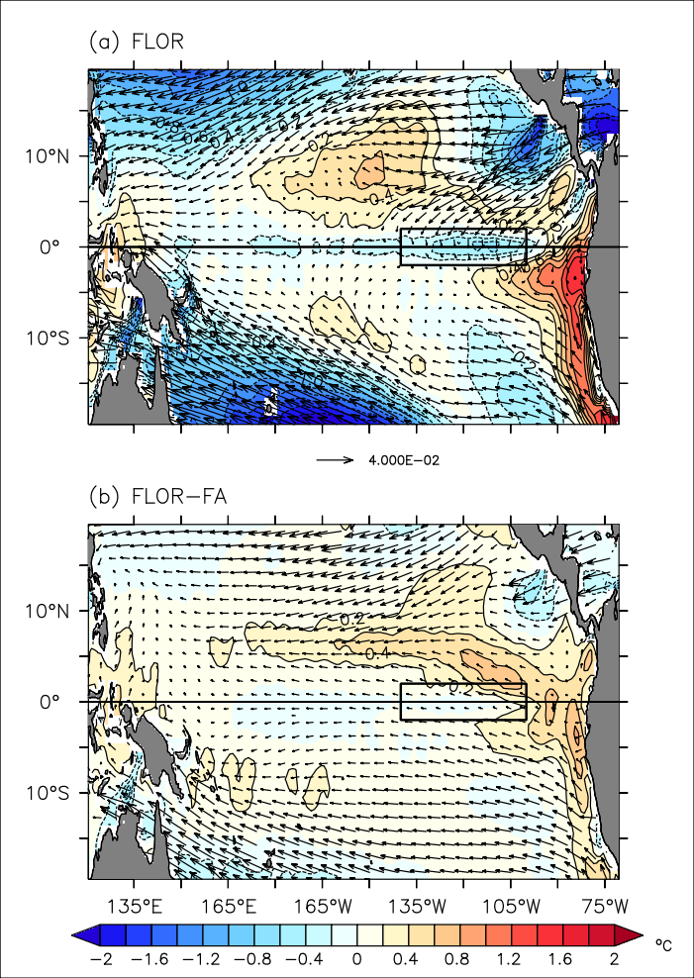
Mean SST biases in FLOR & FLOR-FA
100 year mean of Control simulations
FLOR actually has a rather small (0.6ºC) equatorial cold bias, too cold off-equator, and too warm along the Peru coast
By construction, flux adjustment (FA) corrects the SST bias
Small off-equatorial warm SST bias remains in FLOR-FA
Flux adjustment based on single iteration (additional iterations would remove surface biases completely)
Equatorial Cold Tongue-ECT
Ray et al (in prep)
Notes:
ATW: State time range of mean. 30 years?

Slide 4
GFDL CM2.5-FLOR
”Forecast Oriented Low Ocean Resolution” (FLOR) version of GFDL CM2.5
  Improves simulations and forecasts of regional climate and extremes, relative to CM2.1
  Refines resolution in atmosphere only; less expensive than full CM2.5
  Used for routine seasonal predictions, contributed to NMME
Atmosphere and Land (CM2.5)
  ~50 km resolution using a cubed sphere finite volume core, 32 levels
Ocean (CM2.1-like)
  MOM4, 1ᴼ-0.30 ᴼ, 50 levels with 10m spacing in upper 270m
  z* vertical coordinate
  more realistic solar absorption
  Biharmonic horizontal viscosity scheme – less damping of TIWs
  higher order advection scheme-piecewise parabolic method
300 year control runs - fixed 1990 values of atmospheric composition, solar forcings, land cover – monthly-mean output
Flux adjusted version – corrected surface climate - FLOR-FA
30 years control run of FLOR and FLOR-FA with daily output
1 year run with hourly output

Slide 5
Schematic of physical processes in ECT
surface heat flux
submonthly meridional advection
North
2°N
Equator
Monthly merid flux
East
140°W
100°W
2°S
Mixed layer
total diffusive
heat flux
Depth
MLD
monthly
upwelling
Ray et al (in prep)
submonthly
vertical advection
Heating - net surface heat flux , submonthly meridional & vertical advection
Cooling – downward diffusive flux, monthly upwelling, monthly meridional flux divergence
Notes:
ATW: Let me know if I screwed up with these edits. I was trying to do it for obs, but midway through I started thinking that maybe you were trying to do it for FLOR… Check especially the submonthly vertical advective flux, both in your diagram and in the summary bullets at the bottom.

Slide 6
Approximate the stationary ML
Estimating a temporally varying ML heat budget is complex
  Needs to approximate the ML volume with ML changes
  Exact formulation of the entrained/detrained water
  monthly means are commonly available
We estimate the exact heat budget of an hourly varying ML
A stationary ML simplifies the heat budget
  It eliminates the entrainment
  Same ML volume
  May be less representative of the average mix of processes affecting SST
How to define a relevant stationary ML that approximates the fully varying ML?

Slide 7
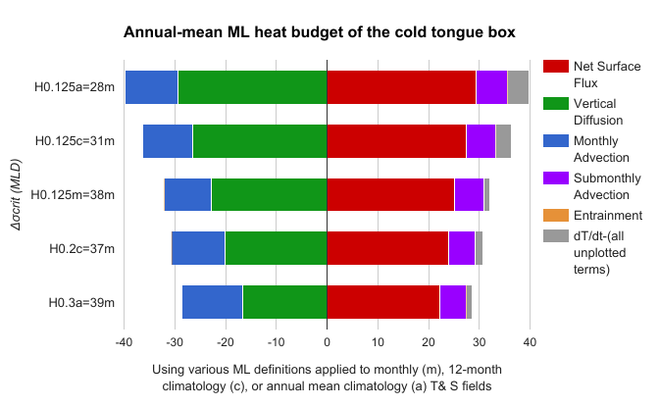
Choosing the ML depth for the heat budget
Due to skewed ML in eastern equatorial Pacific, a deeper density criterion difference (0.3 kg/m³ compared to 0.125 kg/m³) approximates the mean monthly varying ML

Slide 8
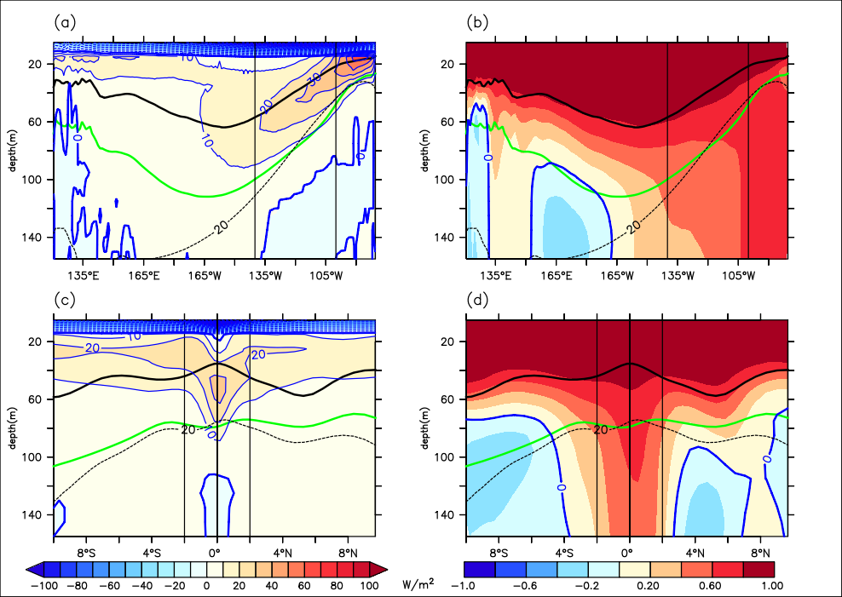
Surface Mixed Layer, and Deeper Layer
Layer of downward diverging diffusive heat flux
Equatorial section of the mean vertical diffusive heating (K/year)
Layer of converging flux
Highly correlated with SST
Annual mean
surface layer
Contains the diffusion
ECT
Deeper annual mean layer that subsumes most of the vertical diffusive flux
Ray et al (in prep)
Vertical diffusivity transports heat down the vertical temperature gradient, cooling the surface and heating the subsurface above the thermocline

Slide 9
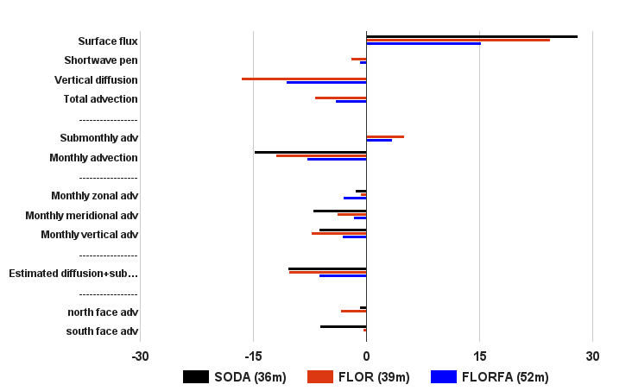
Surface Mixed Layer Heat Budget
FLOR (30 years)
Ray et al (in prep)
+
-
Net surface heating
Dominant cooling
Model diagnosed
Additional cooling
Submonthly heating
Offline
Monthly cooling
Offline
-30
-15
0
15
30
-
K/year
+
Heating - net surface heat flux (mainly) + submonthly advection
Cooling - vertical diffusion (mainly) + monthly advection
Monthly advective cooling is countered by submonthly heating from TIWs
ECT

Slide 10
Surface Mixed Layer Heat Budget
FLOR (30 years), SODA 2.2.4 (1980-2010), TropFlux.v1 (1980-2010)
Ray et al (in prep)
+
-
Less monthly cooling
Less meridional cooling
Estimated residual in FLOR is realistic
Much less cooling at south face of ECT (2°S)
-
K/year
+
FLOR has less advective cooling (near the surface) than SODA
Notes:
The components of monthly advection shows dominant cooling from meridional and vertical fluxes. Warm bias in meridional advection due to lack of cooling at the south face of ECT box, triggers the warm bias in monthly advection. Except for the zonal advective cooling, FA decreases the magnitude of advective cooling. The estimated residual from surface heat flux and monthly advection, that comprises vertical diffusion and submonthly advection is realistically simulated in FLOR

Slide 11
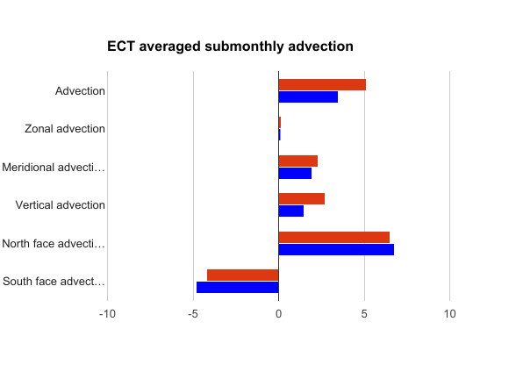
Surface Mixed Layer Heat Budget
FLOR (30 years), FLOR-FA (30 years), SODA 2.2.4 (1980-2010), TropFlux.v1 (1980-2010)
Ray et al (in prep)
-
K/year
+
FLOR-FA deepens equatorial thermocline, weakens heat budget terms (except zonal advection), shifts advective cooling downward
Notes:
The components of monthly advection shows dominant cooling from meridional and vertical fluxes. Warm bias in meridional advection due to lack of cooling at the south face of ECT box, triggers the warm bias in monthly advection. Except for the zonal advective cooling, FA decreases the magnitude of advective cooling. The estimated residual from surface heat flux and monthly advection, that comprises vertical diffusion and submonthly advection is realistically simulated in FLOR

Slide 12
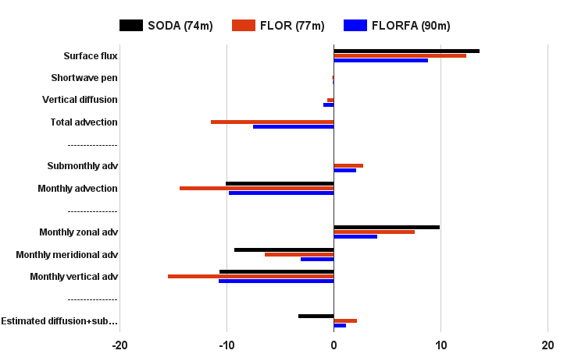
Deeper Layer Heat Budget
FLOR may underestimate the cooling from shear driven vertical mixing
Heating from surface fluxes
Vertical diffusion completely subsumed
Advective cooling balances surface heating
Submonthly heating
Too much monthly cooling
Weaker zonal advective heating
Excess cooling from upwelling
Estimated residual in FLOR is opposite to Observed
-
K/year
+
Notes:
The averaged heat budget in the deeper ML layer shows advection completely balancing the surface heating. Again FA decreases the magnitude of the terms.

Slide 13
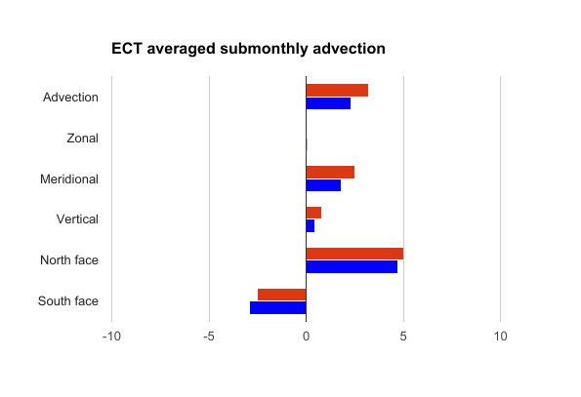
Deeper Layer Heat Budget
Submonthly advective heating components
Heating from the north face – TIWs
FLOR-FA weakens the heat budget terms, but realistically simulates the vertical advective cooling of the deep layer
Notes:
The averaged heat budget in the deeper ML layer shows advection completely balancing the surface heating. Again FA decreases the magnitude of the terms.

Slide 14
Schematic of physical processes in ECT
surface heat flux
submonthly meridional advection
North
2°N
Equator
Monthly merid flux
East
2°S
Mixed layer
total diffusive
heat flux
Depth
submonthly
diffusive cooling
MLD
monthly
upwelling
Ray et al (in prep)
submonthly
vertical advection
Heating - net surface heat flux , submonthly meridional & vertical advection
Cooling – downward diffusive flux, monthly upwelling, monthly meridional flux divergence
May underestimate submonthly diffusive cooling (weak TIW shears)
Notes:
ATW: Let me know if I screwed up with these edits. I was trying to do it for obs, but midway through I started thinking that maybe you were trying to do it for FLOR… Check especially the submonthly vertical advective flux, both in your diagram and in the summary bullets at the bottom.

Slide 15
TIWs in observation and FLOR, FLOR-FA
High TIW activity in observation
Decrease in TIW activity
The bias in meridional temperature gradient amplifies the SST anomalies
FLOR-FA further underestimates the SST anomalies on correcting the meridional temperature gradient, and perhaps with similar stirring as in FLOR

Slide 16
Temporal variation in FLOR ML Heat Budget –ECT
La Niña Composite
Seasonal cycle in SML heat budget (K/year)
Net surface heating
Submonthly advection
Residual from all other
Monthly advection
Vertical diffusion
Diffusion is a strong cooling term in boreal autumn, countered by enhanced submonthly heating and surface flux
Diffusion is a strong cooling term in boreal autumn of La Nina years
Monthly advection increases (meridional & vertical) in boreal summer of La Niña years
Increased submonthly advection during La Niña
(0)
(+1)

Slide 17
Summary
Diagnose mixed layer heat budget in FLOR: (1) exact and time-varying, or (2) simplified for two key stationary layers
SML: Vertical diffusion primarily balances surface heating
Deeper Layer: subsumes vertical diffusion; advection balances surface heating
Net submonthly advection (meridional + vertical) heats the ECT in FLOR – particularly during boreal autumn of La Niña years
FLOR may underestimate the submonthly diffusive cooling due to shear-driven vertical mixing associated with TIWs. FLOR may compensate via stronger monthly vertical advective cooling at depth.
Stronger current shear north of equator (SEC-NECC) in FLOR-FA did not improve TIW induced submonthly equatorward heat advection
Models need to resolve TIWs – higher horizontal and vertical resolution, improved diffusive parametrizations
Need observational estimates of submonthly advective heating and diffusive cooling (TIWs)
Ray, S., A.T. Wittenberg, S. Griffies, and F. Zeng (in prep): Understanding Equatorial Pacific Cold Tongue: Insights from the Oceanic Mixed Layer Heat Budget
Notes:
You’ll have to remind me why submonthly vertical advection was a heating effect in FLOR… I know we’ve been through it, I just forgot…

Slide 18
Thank You!

Slide 19
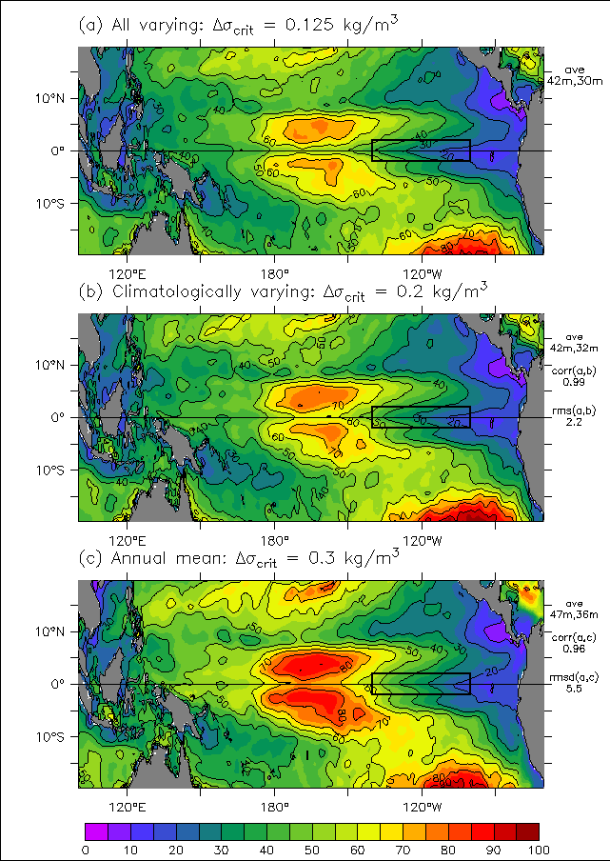
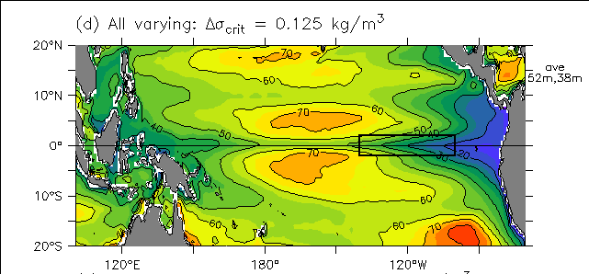
Mixed layer depth: Obs vs. FLOR
SODA 2.2.4 Mean=42m
Equatorial MLD is highly skewed
Tropical Pacific ML in FLOR is 10m deeper than observed
Cold Tongue ML is 8m deeper in FLOR
Large diurnal, seasonal, interannual variations
Δσ_{crit}=0.125kg/m³
30m
FLOR Mean=52m
38m
Static MLD based on annual-mean fields (Δσ_{crit}=0.3kg/m³) approximates annual-mean MLD from monthly varying fields (Δσ_{crit}=0.125kg/m³)
Ray et al (in prep)

Slide 20
Mixed layer heat budget
v
Schematic of advective fluxes
T
T
reference
temp
T_{r}
T
u
Temperature
tendency
Lee et al (2004)
w
Vertical diffusion
all other terms
+
Entrainment
Net surface heat flux
Horizontal advection
Vertical advection
Kim et al (2007) flux form
Except entrainment, all heat budget terms are diagnosed by model at model time step (hourly)

Slide 21
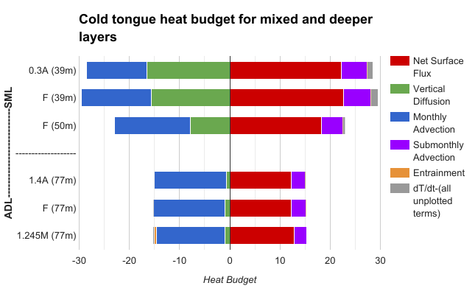

Slide 22
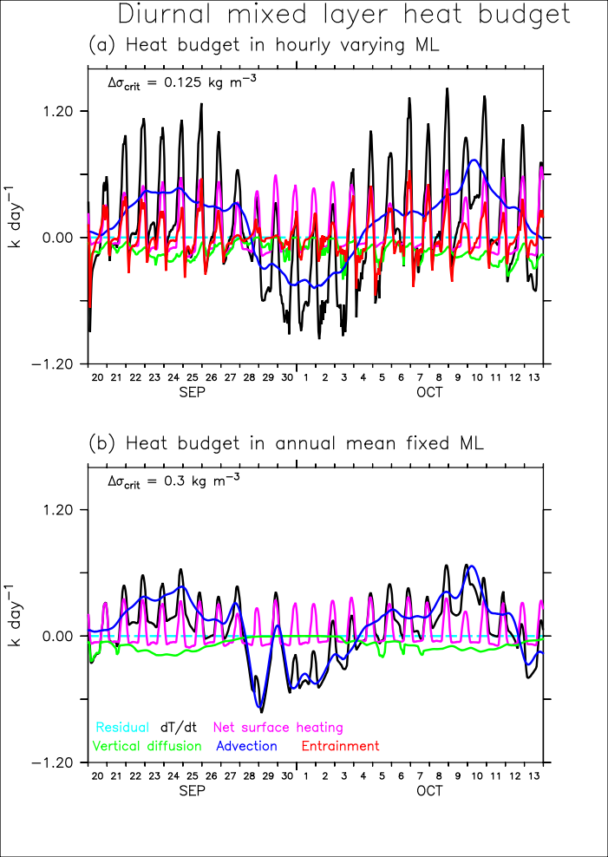
Diurnal mixed layer heat budget
125°W, Eq
ML temperature change
Detrainment heating
Net surface heating
Diffusive cooling
Residual
Hourly ML
Advective cooling and heating
Diurnal variations
Vertical diffusion – nighttime cooling`
Fixed ML-annual mean
Fixing the ML eliminates entrainment (differs from hourly ML budget)
Ray et al (in prep)

Slide 23
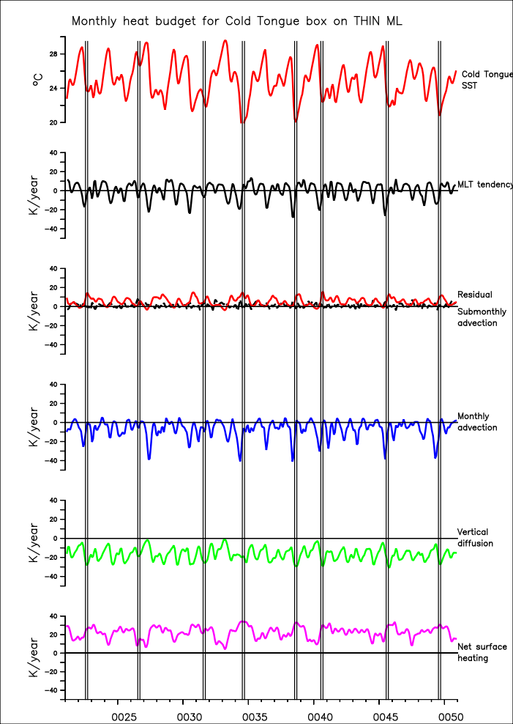
Monthly ECT ML heat budget
Residual is very small compared to other heat budget terms
Heating from surface fluxes and submonthly advective fluxes is countered by diffusion and mean advection
Submonthly advective heating is maximum in Aug-Oct, months of active TIWs, especially preceding a La Nina

Slide 25
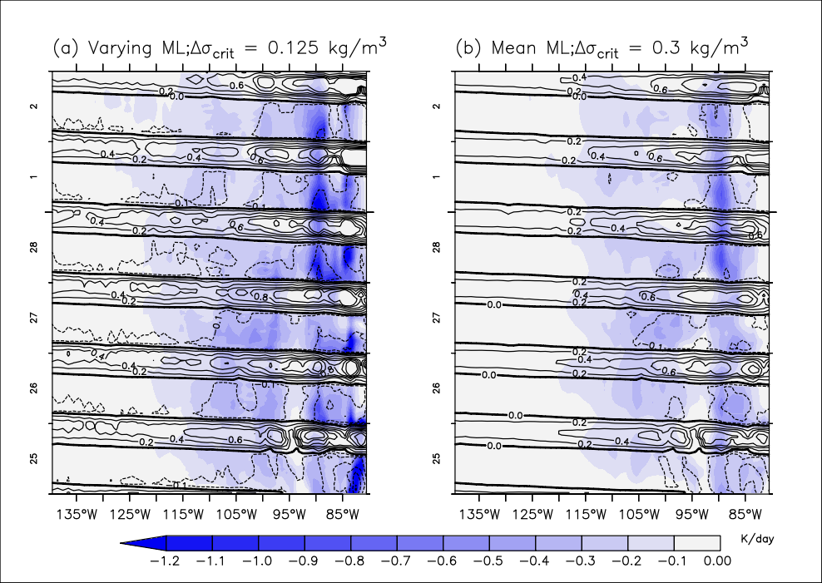
Nighttime vertical diffusion accumulates
Vertical diffusion (K/day), contoured over by the net surface heating (K/day), averaged over by shallow annual mean mixed layer
Nighttime diffusive cooling, long wave cooling
Days
Daytime surface flux heating, less diffusive cooling
Accumulated diurnal vertical diffusive cooling

